Slide 1

SMA Electives
Who: Current sophomores and juniors
When: You must register for electives in pairs (fall AND spring semesters)

Slide 2
Half-credit electives must be paired.
Students must choose an elective from each column to credit a full credit (Column A and B OR Column C and D).
Column A | Column B
Organic Chemistry | Biochemistry
Algorithm Development | Statistics using R
Linear Algebra | Intro to Mathematical Logic
Bacteriology | Zoology
Column C | Column D
Robotics | Microcontrollers
Pre-Engineering | Design Engineering/CAD
Kinesiology | Biotechnology

Slide 3
Fall SMA Electives

Slide 4
Fall 2026-27
Linear Algebra
Algorithm Development for Applications
Organic Chemistry
Research Methods in STEM
Pre-Engineering
Kinesiology
Robotics

Slide 5
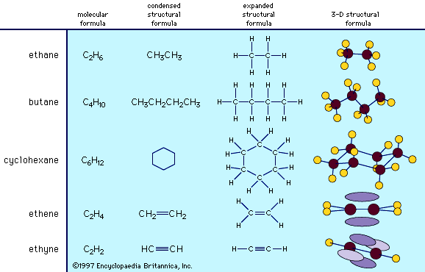
ORGANIC CHEMISTRY

Slide 6
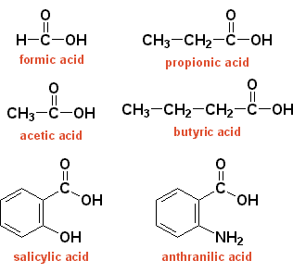
Nonmetallic Compounds of C and H
Chemistry of functional groups, including:
  alcohols
  aldehydes
  ketones
  acids
  amines

Slide 7
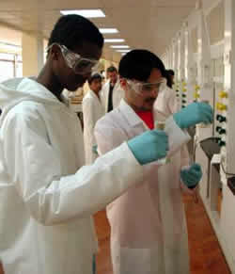
Organic Chemistry
Lots of LABS!
  Isomerization
  Reaction Mechanisms
  Redox Reactions
  Extraction Techniques
  Aldol Condensations
  Functional group conversions
  Boiling Point and Melting Point Determination
  Solubility Tests
  Polymers
  Infrared Spectroscopy
  Gas Chromatography

Slide 8
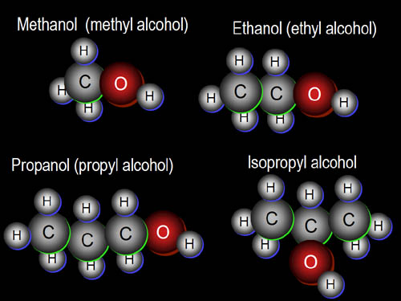
Organic Chemistry
Alkanes, alkenes, alkynes
Alcohols, Aldehydes, Ketones
Carboxylic Acids, Amines
Amides, Esters, Ethers
Acetals, Hemiacetals
Great for AP Chem students!

Slide 9
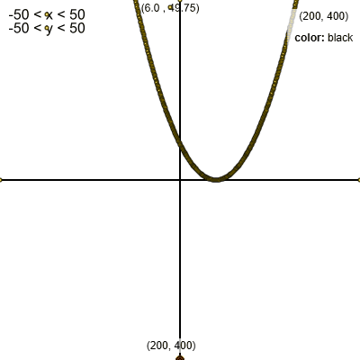

Algorithm Development for Applications
Mr. Polack
This course places an emphasis on producing clear, robust, and reasonably efficient code using top-down design, informal analysis, and effective testing and debugging. We will use Python to implement our algorithmic thinking, and several graphics packages to create interesting visual applications.
Use Processing to generate the Mandelbrot fractal!
Build a graphing calculator to visualize Newton's Method!

Slide 10
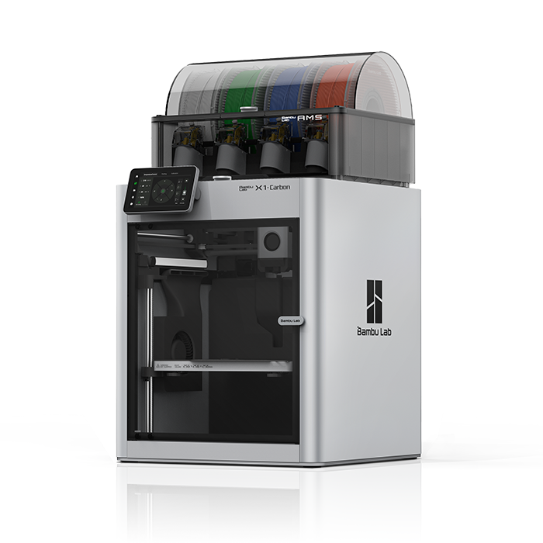

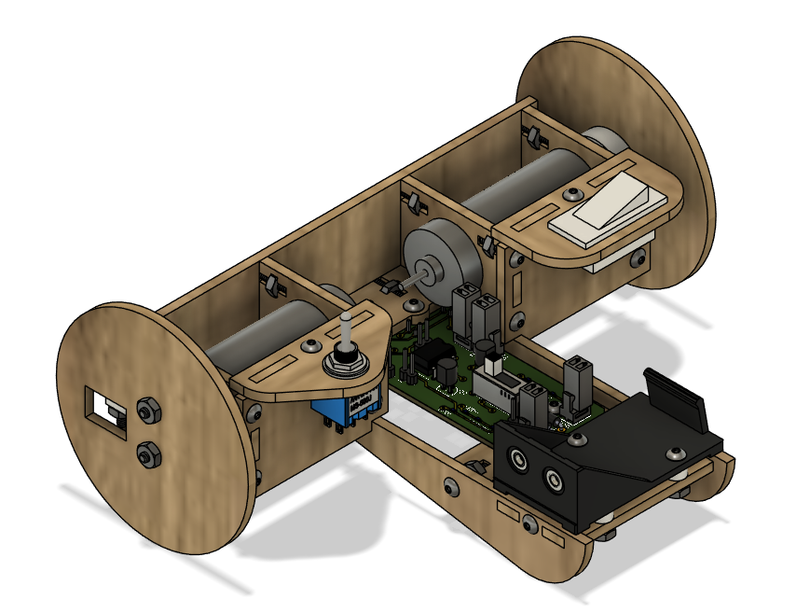
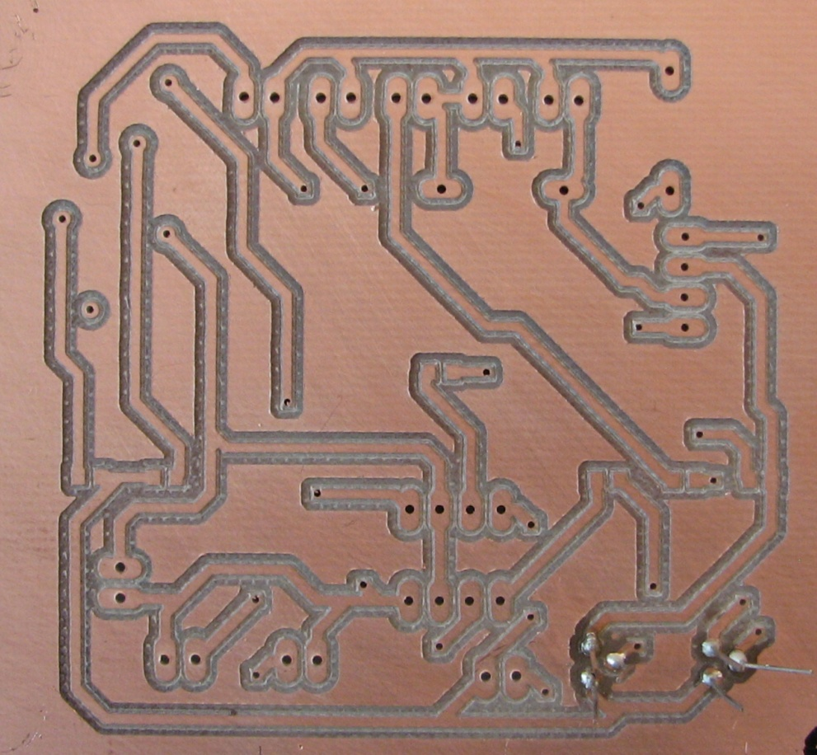
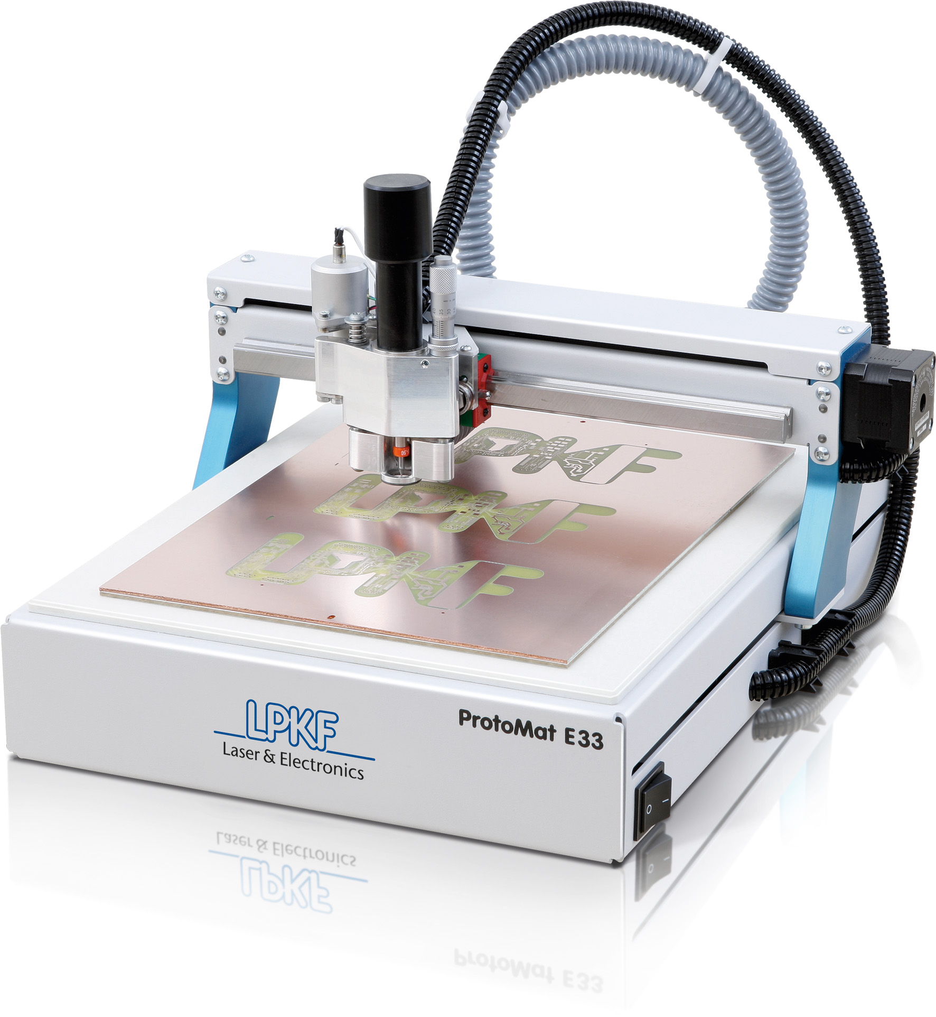
Robotics Elective
Learn the basics of analog circuits
Design and make a printed circuit board
Build a line following robot
Use Autodesk Fusion
Minimal homework
NO computer programming
See Mr. Evans for questions.

Slide 11
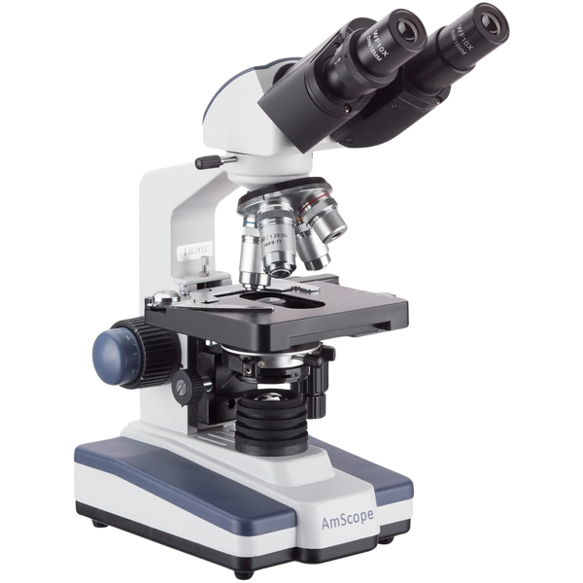
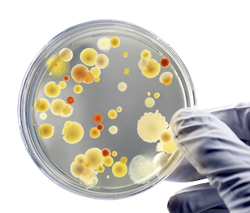

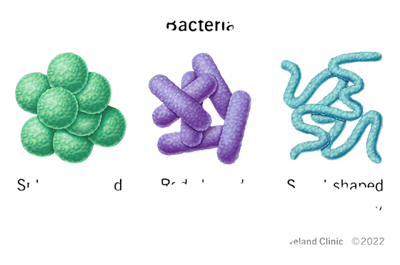
BACTERIOLOGY
Morphology & physiology of bacterial cells
Mechanisms of bacterial pathology
Chemical and drug resistance testing
Media use and culturing
Differential staining techniques
Microscope use

Slide 12
Linear Algebra
Ms. Liberto
Basic concepts/topics covered in this course:
Systems of Linear Equations
Matrices (Operations, Inverses, Determinants, Eigenvalues)

Slide 13
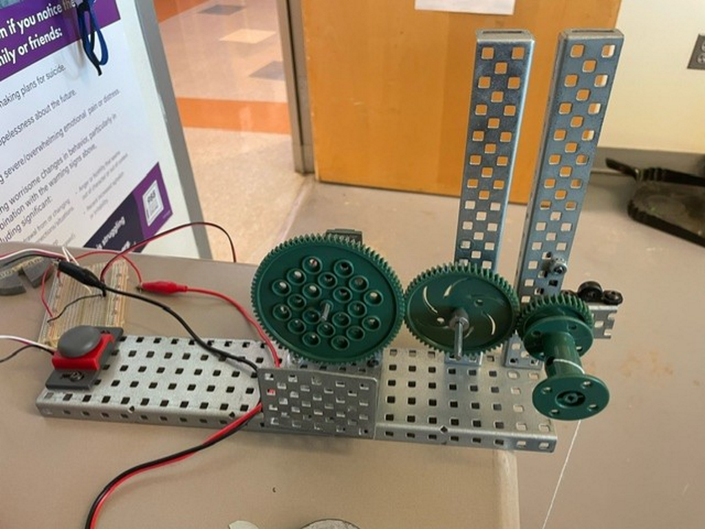
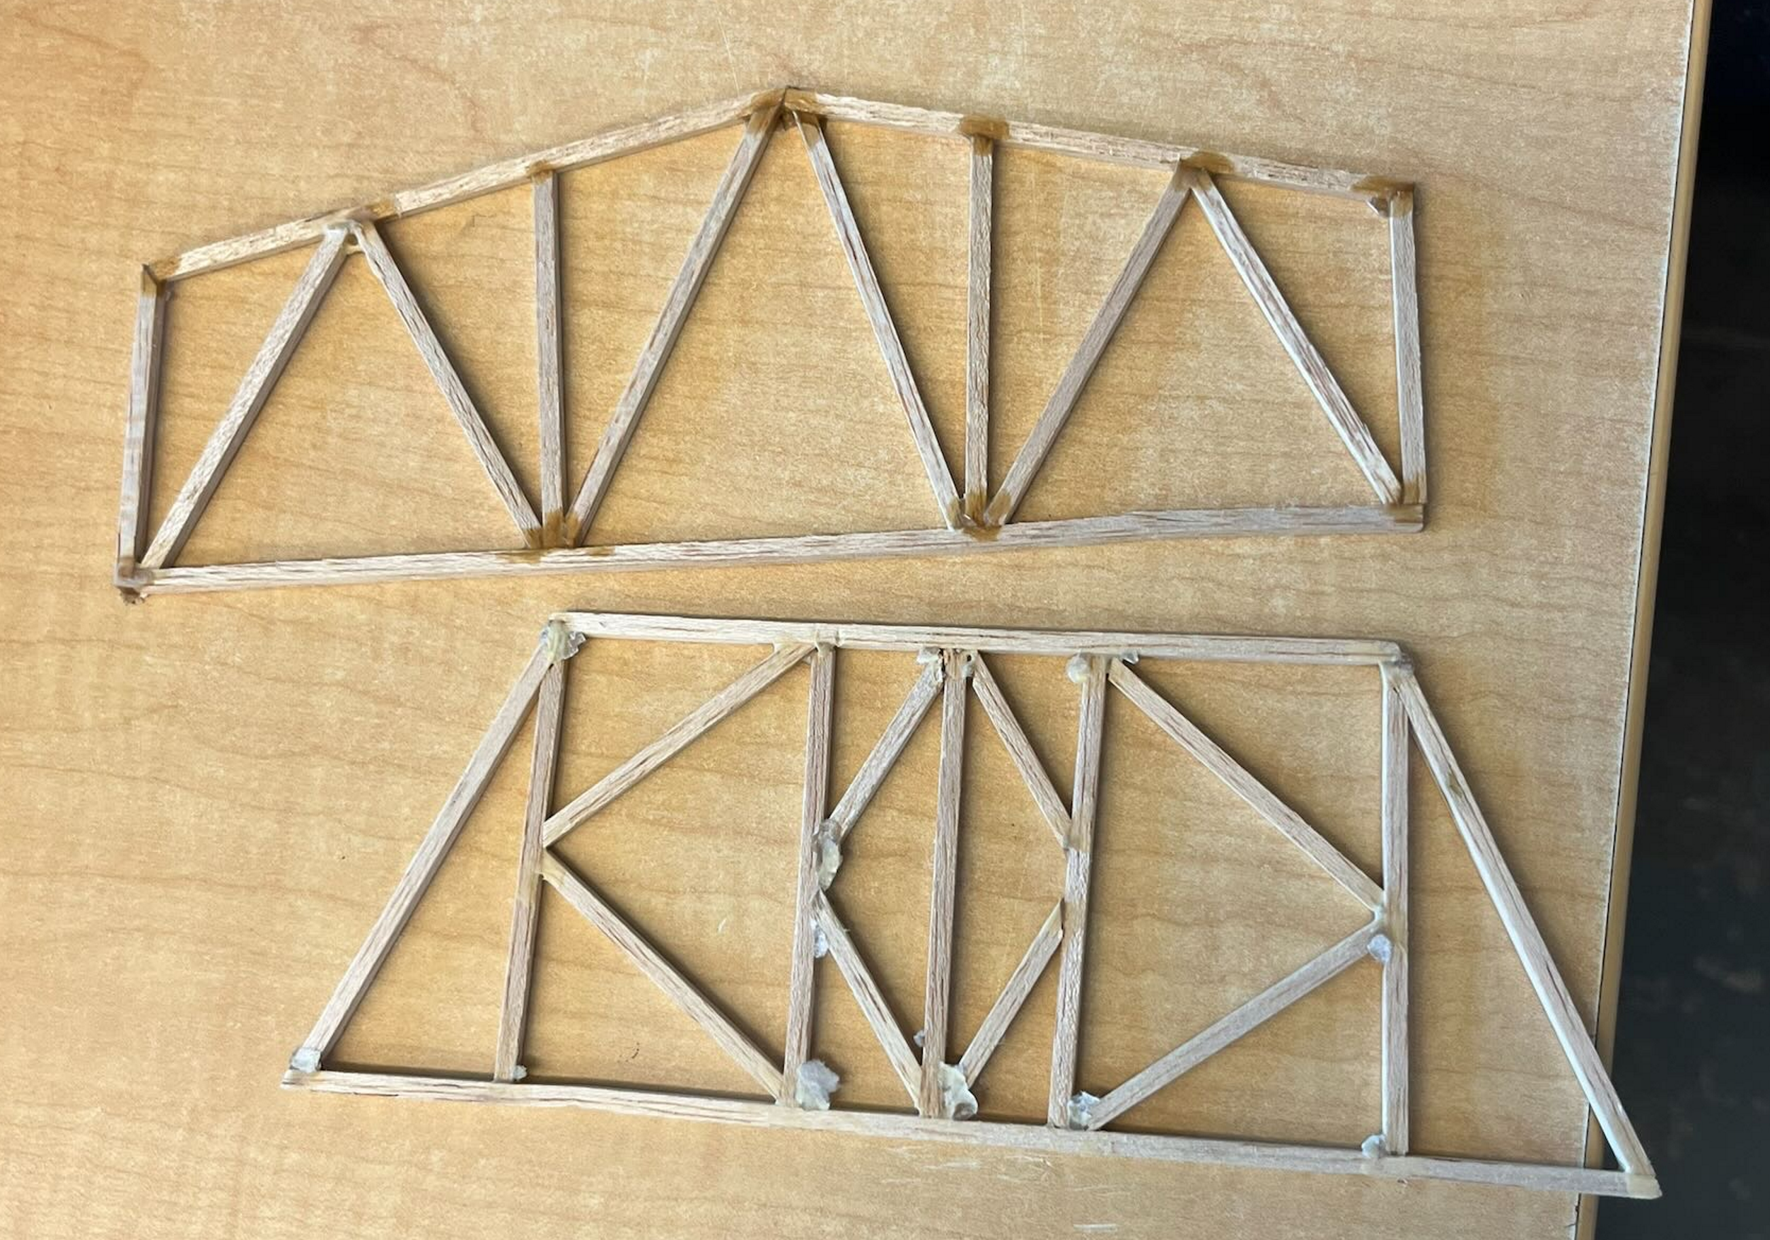
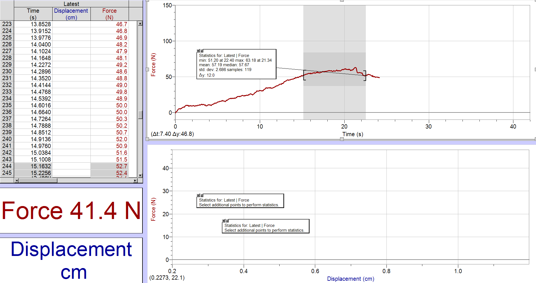
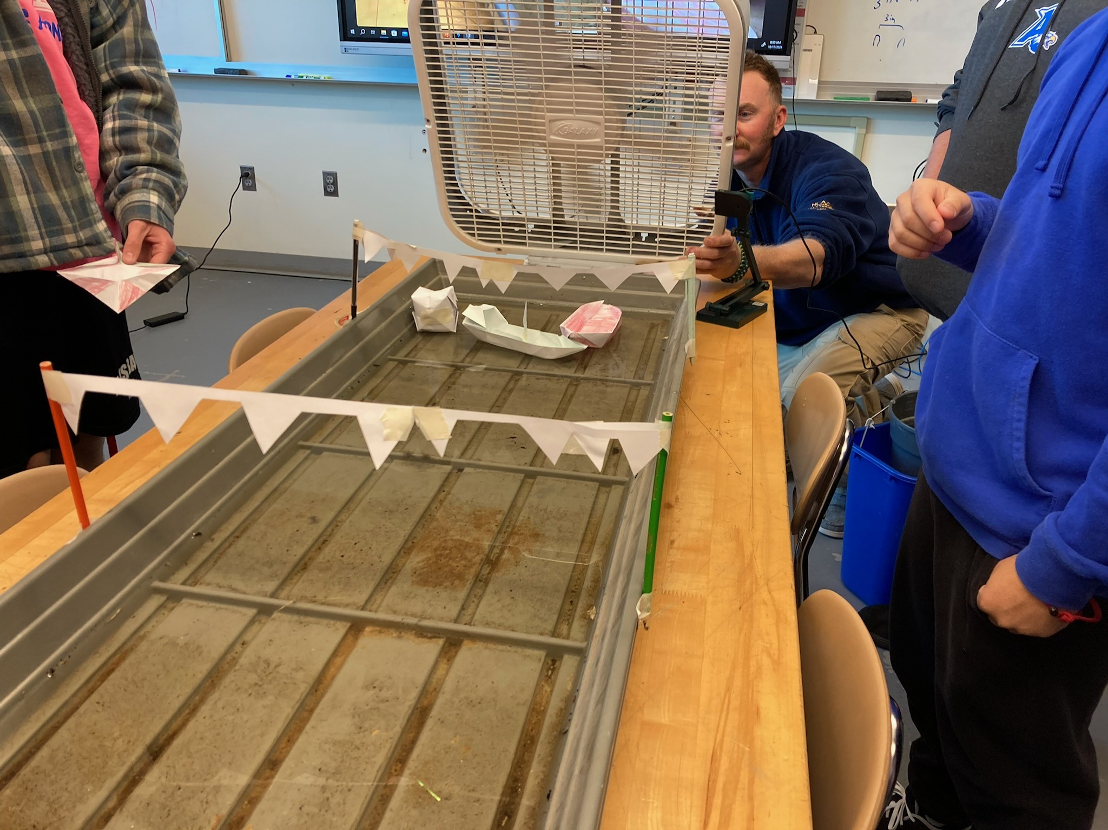
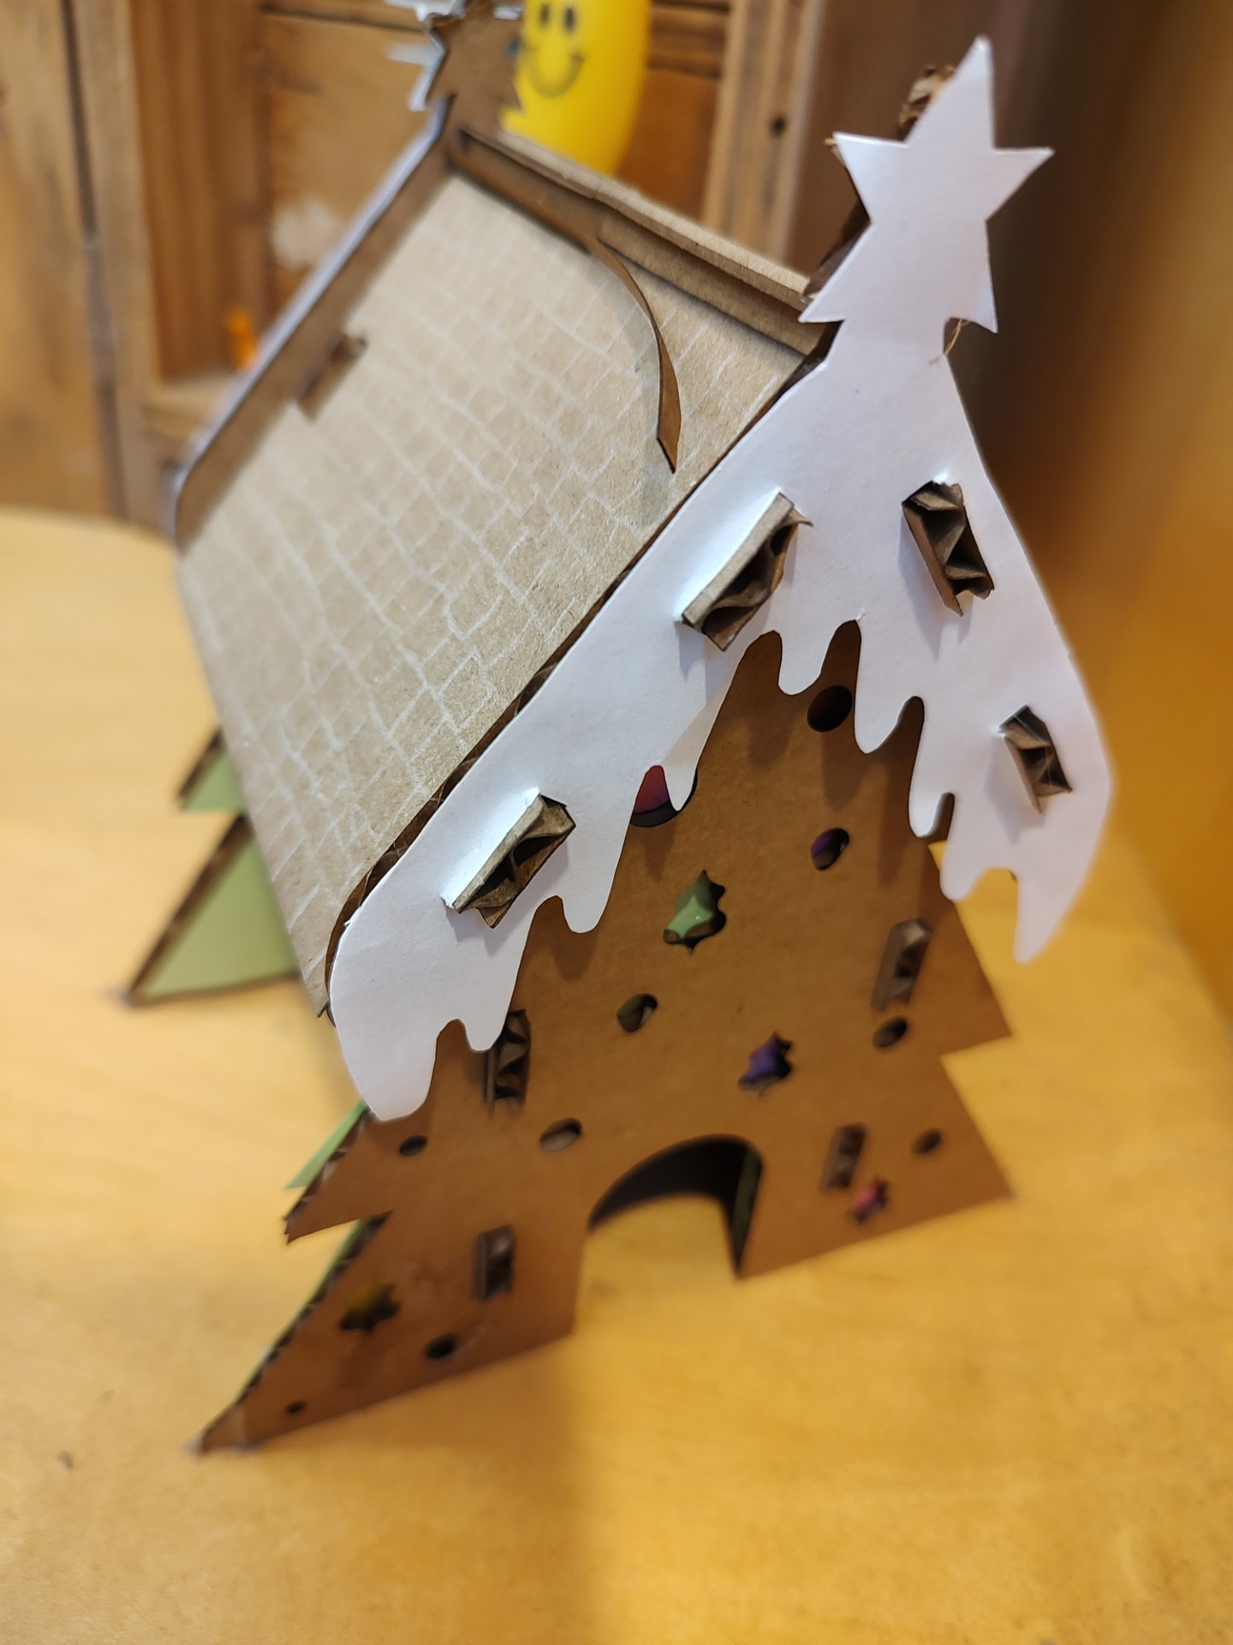
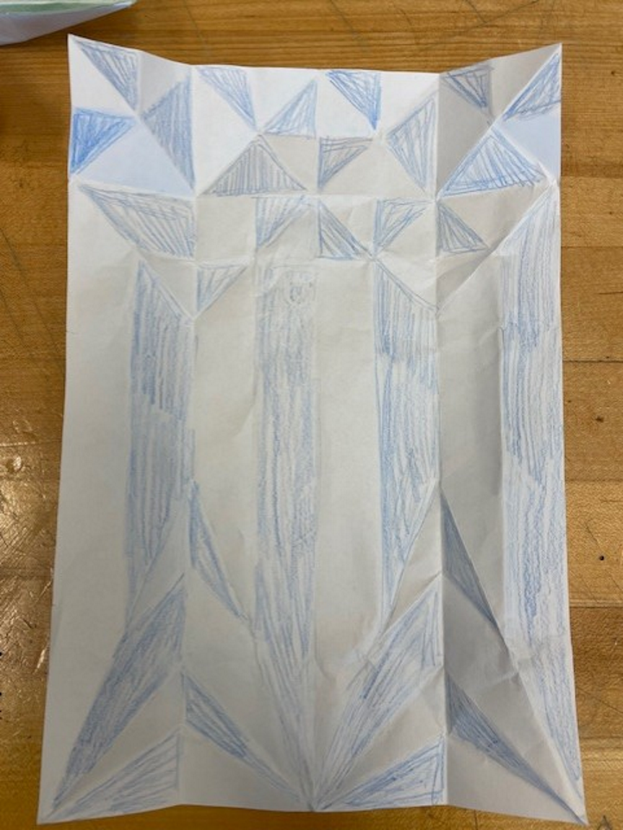
Pre Engineering
Who should Take this course? Anyone who… ​
is interested in engineering​
likes to figure things out​; and develops creative solutions to problems
Likes doing projects
enjoys working in teams​
Wants to explore the branches of engineering
See Mr. Webster if you have questions

Slide 14
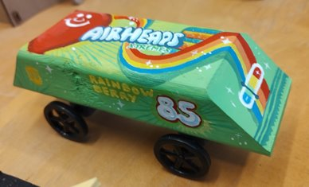
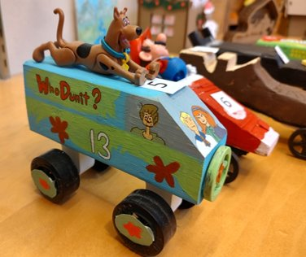
Pre Engineering
Unit 1: Energy and Power
  The goal of Unit 1 is to work with mechanisms, energy sources, and alternative energy applications.
Unit 2: Materials and Structures
  The goal of Unit 2 is for students to have a more concrete understanding of engineering through materials properties and statics.
Unit 3: Control Systems
  The goal of Unit 3 is for students to recognize the abundance of and infinite variety of computer use in our daily lives.
Unit 4: Statistics and Kinematics
  In Unit 4 students are engaged in learning to use statistics to evaluate an experiment. Later they begin a study of dynamics, specifically kinematics, and apply statistical skills to study freefall motion.

Slide 15
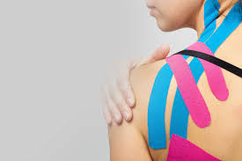
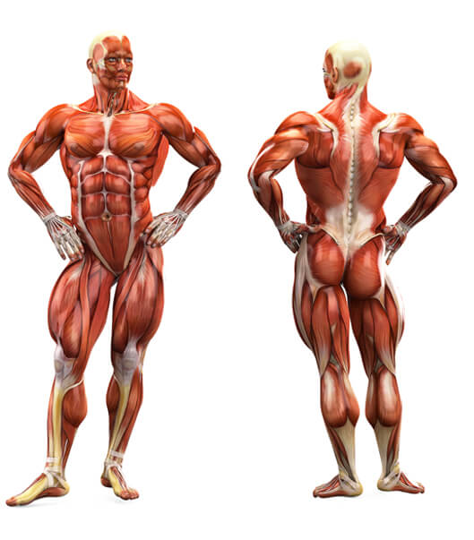
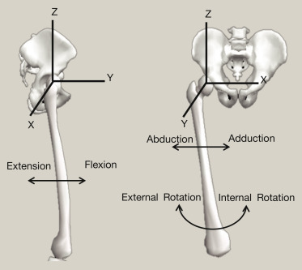
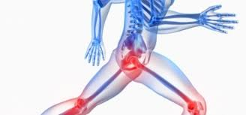
Kinesiology
Study of…
Bones
Joints
Muscles
Strength
Flexibility
Joint motion
fractures
Human motion
Orthopedic injuries (ie. ACL, MCL, broken bones, sprains, strains, etc.)
LOTS of labs
LOTS of Yoga or mini workouts
Injury evaluation
Fitness or rehab program planning
Posture assessment

Slide 16
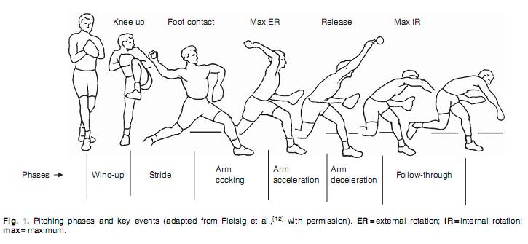
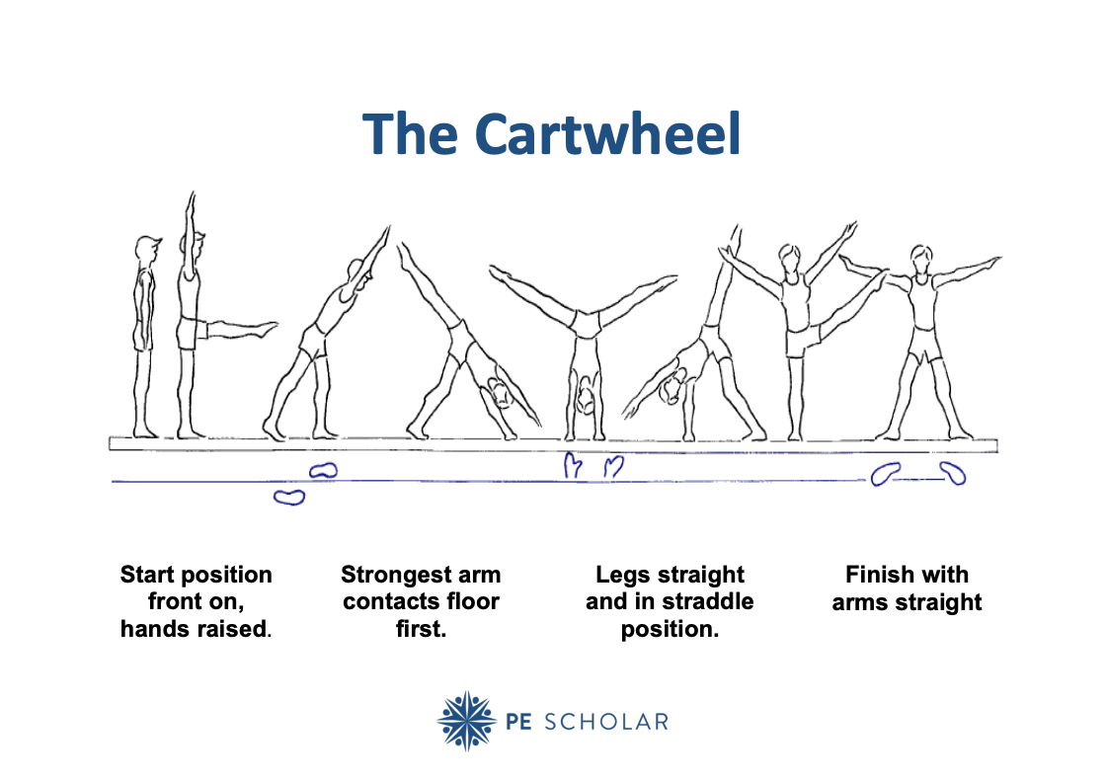
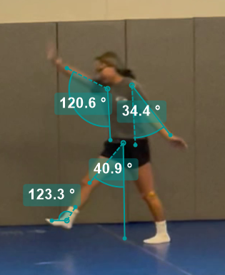
KINESIOLOGY
No homework
Lots of partner or team labs
Fun
Great support class for anatomy

Slide 17
Spring SMA Electives

Slide 18
Spring 2026-27
Biochemistry
Biotechnology
Design Engineering (w/CAD)
Statistics using R
Intro to Mathematical Logic
Microcontrollers
Zoology

Slide 19


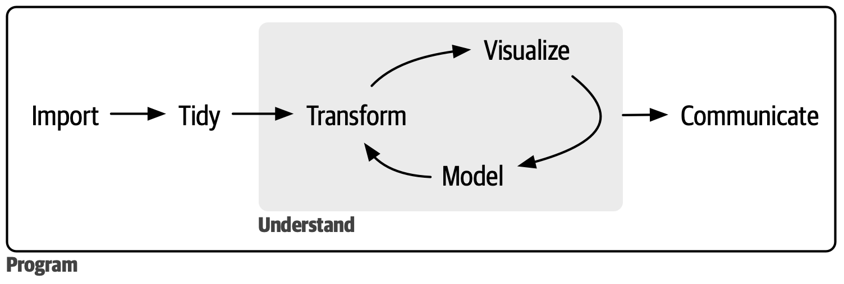
Statistics using R
Mr. Polack
Dive into data science with R programming! Learn to write a markdown report with reproducible methods. We will use a suite of packages called the tidyverse to manipulate and visualize data. We will also apply traditional inferential concepts discussed in AP Statistics, and compare them to more modern techniques including bootstrap resampling and hypothesis testing with randomization.

Slide 20
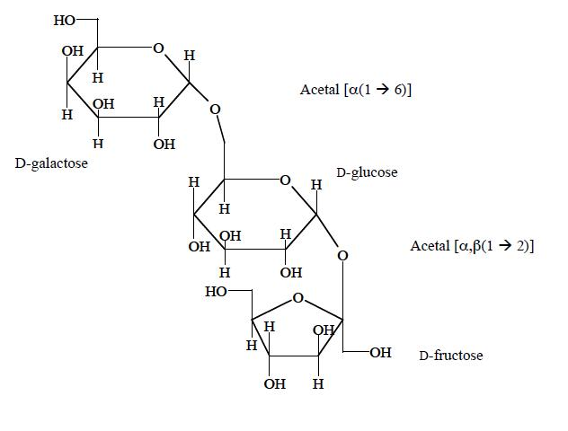
Biochemistry
Organic chem NOT a prerequisite, yet helpful
An expansion of Organic Chemistry and how it is related to Biology.
Relates structure to function

Slide 21
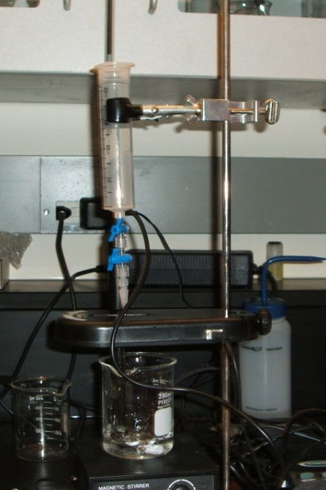
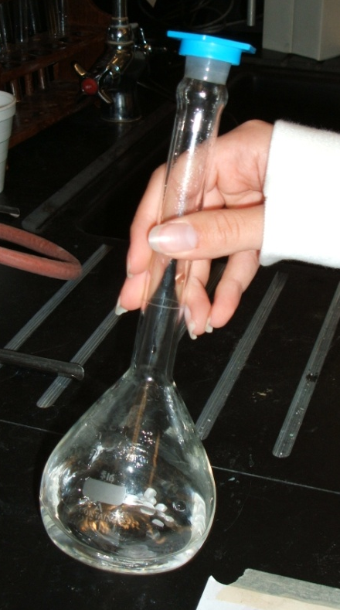
Biochemistry
LOTS of LABS
  Stereochemistry
  Making Nylon
  Making Aspirin
  Making Soap
  Making Perfumes
  Acid-Base Chemistry
  Environmental Stream Water Analyses
  Carbohydrates
  Lipids
  Amino Acids and proteins
  Nucleic Acids
  Metabolism

Slide 22
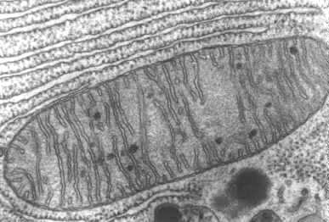
Biochemistry
Extension of organic, primarily carboxylic acids, esters and amines
Effects of chemical polutants on a freshwater stream system
Chemistry behind biological processes
Aerobic and anaerobic respiration
Photosynthesis
Transmission of genetic information
Great for AP Chem or AP Bio students

Slide 23
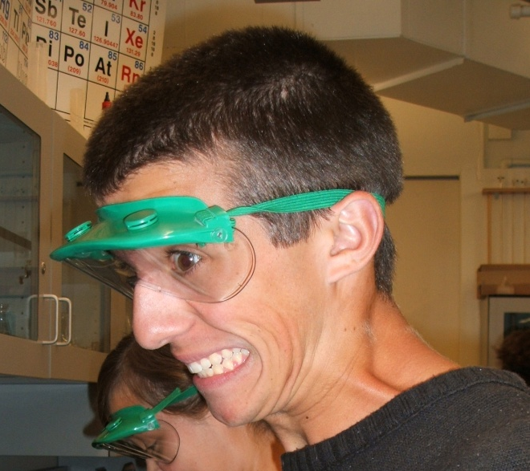
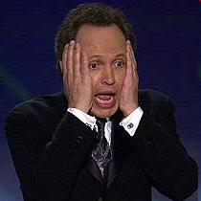
Biochemistry
STUDENTS OVERWHELMED WITH CHEMISTRY EXCITEMENT

Slide 24
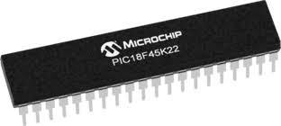

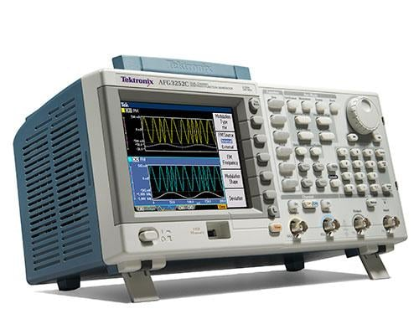
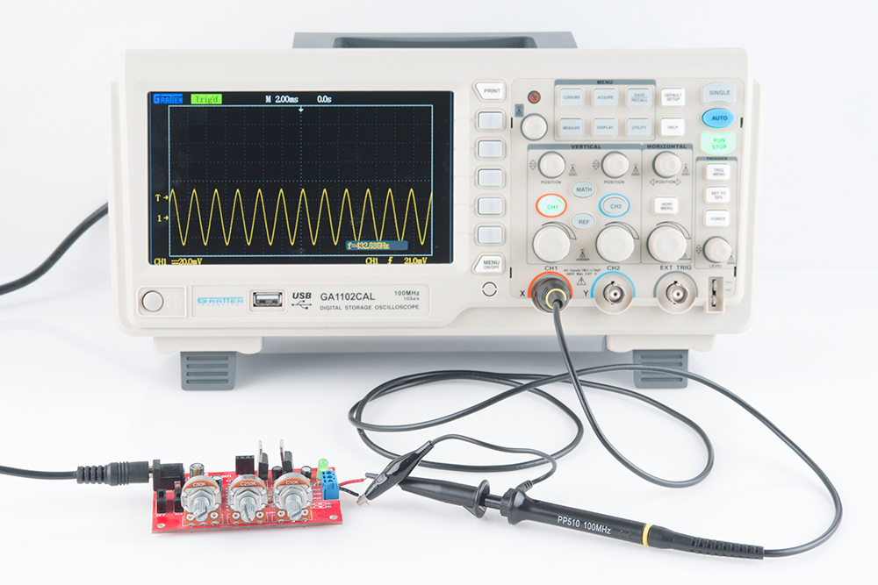
Microcontrollers
If you like programming and wiring, this is the class for you.
We use PIC microcontrollers.
Learn at deeper and more fundamental level than Arduino.
See Mr. Evans with questions about this course.

Slide 25
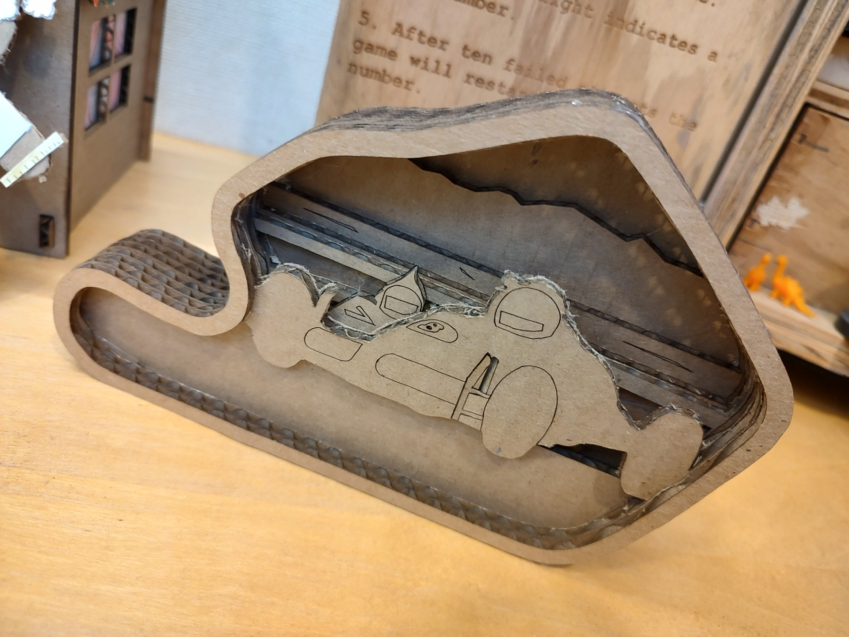
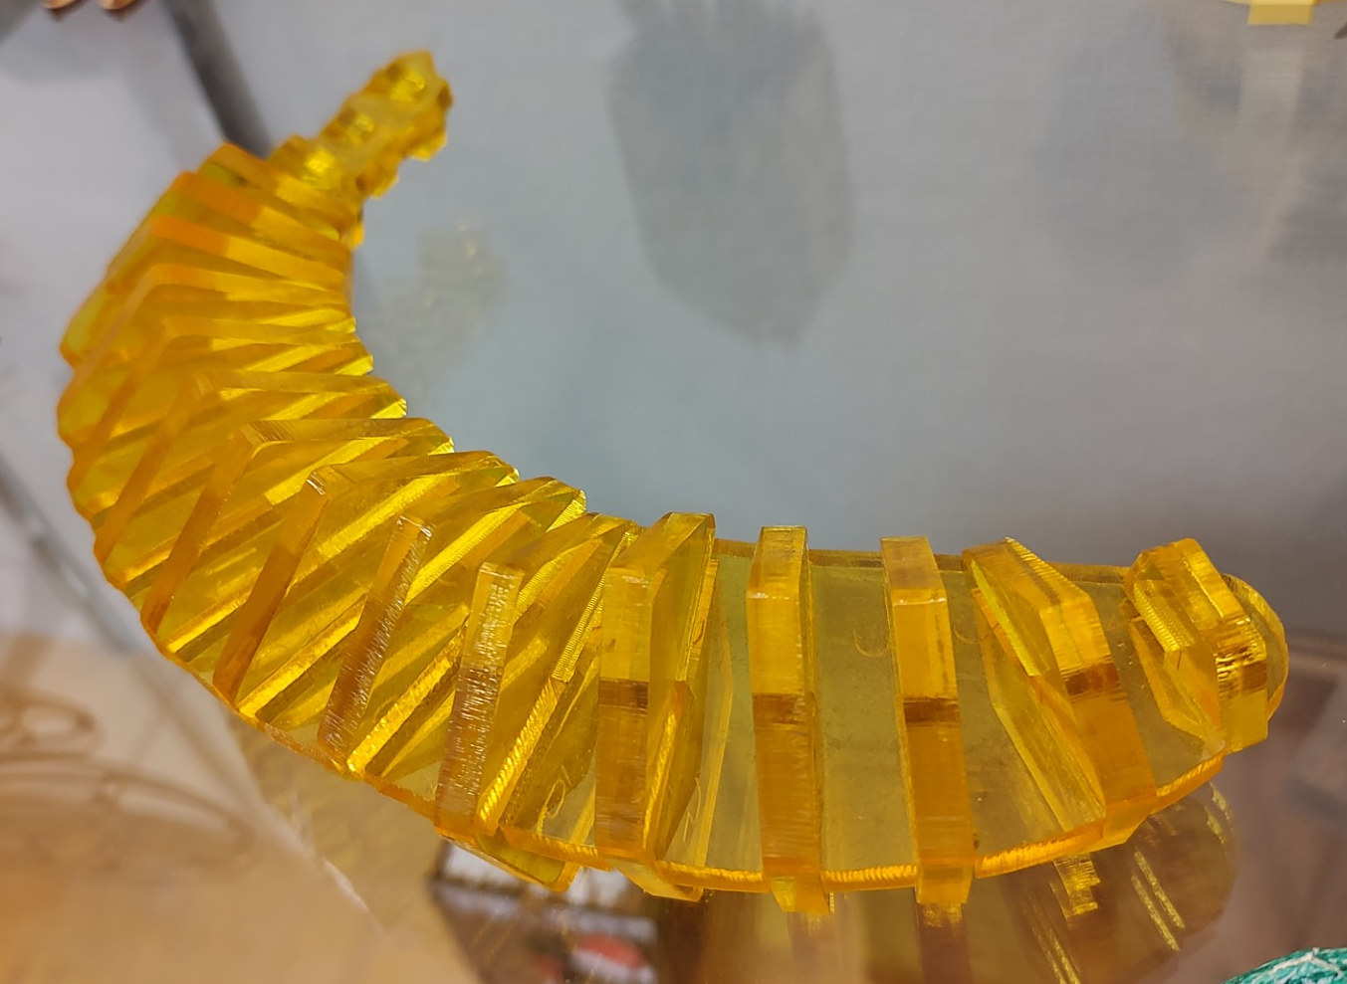
Design Engineering and CAD
Offered Spring Semester
See Mr. Webster with questions

Slide 26
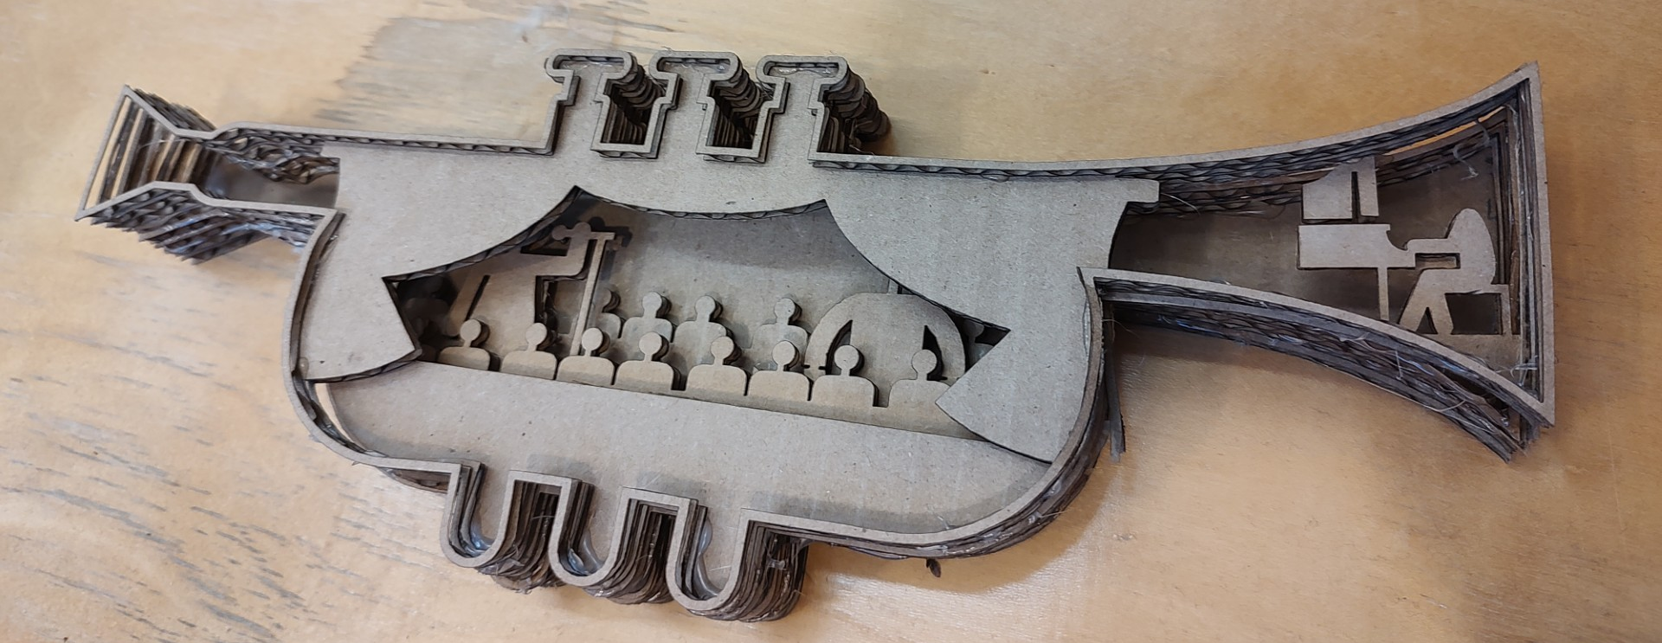
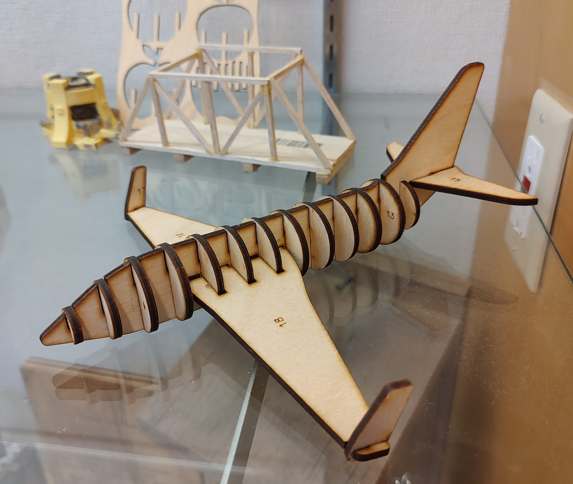
Design Engineering
Students will get to design a project that will incorporate 3D and 2D CAD skills.
Students will learn the mathematics of design features and how to generate flat patterns.
Projects will involve prototyping and design techniques that require additive and subtractive types of CAM functions.

Slide 27
Biotechnology
Training for the future – Mrs. Gabriel

Slide 28
What is Biotechnology
Lab based class with assessments on skills.
Skills to be learned include:
Electrophoresis; PCR; Restriction fragmentation
Micropipetting Certification; DNA extraction
Microscopy; Sterile technique
Labs: Cheese; Antibiotic Resistance; GMO's; Molecular Rainbow; Foods on Mars; eDNA; Shark Attack DNA; Who's the Doggie Daddy?; Genotype to Phenotype PCR
PREREQUISITES: Chemistry and Biology

Slide 29
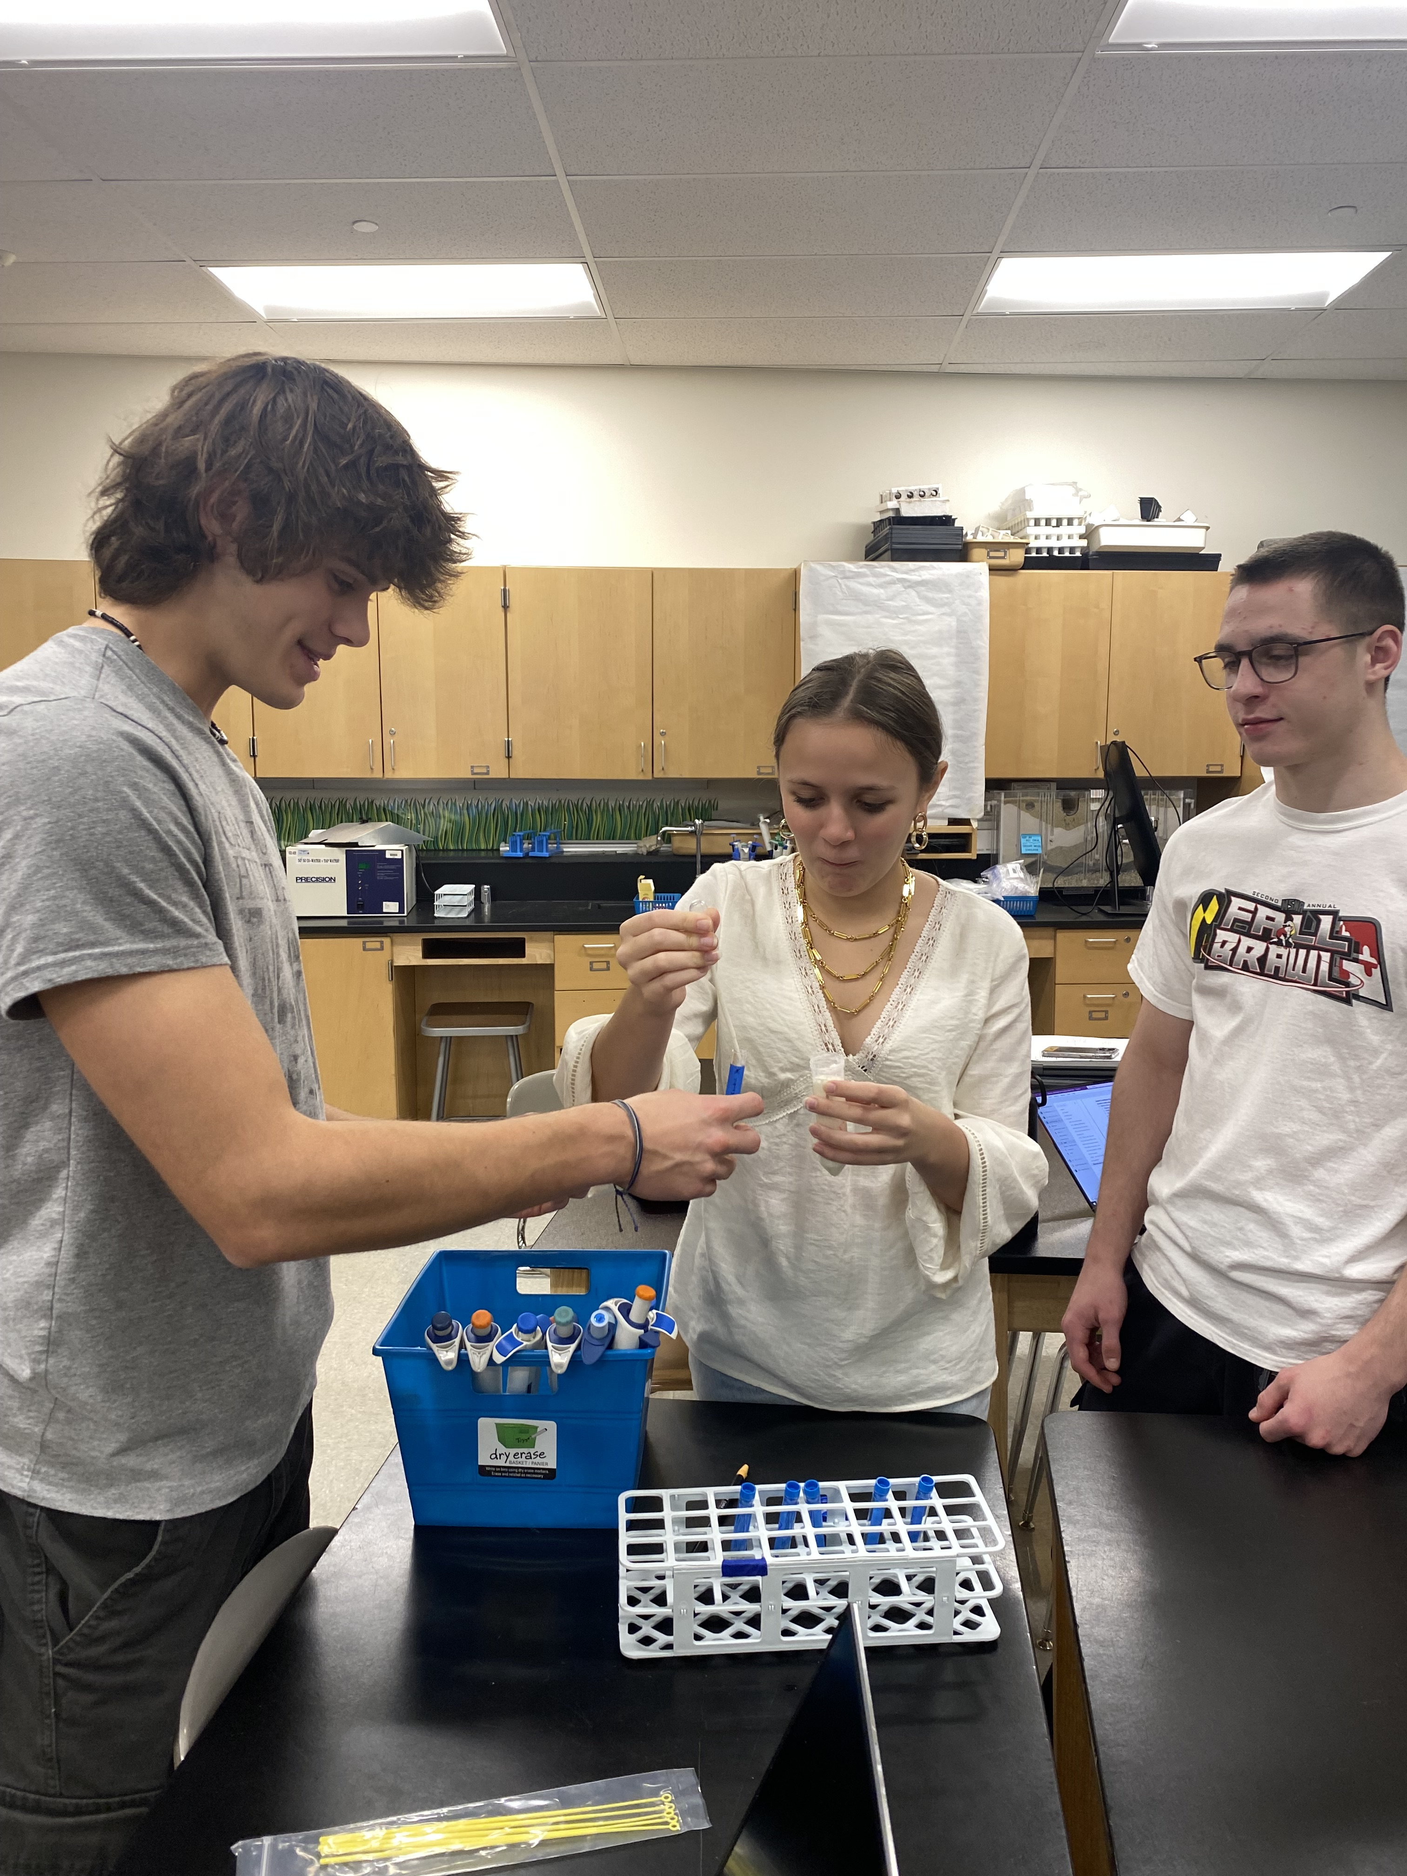
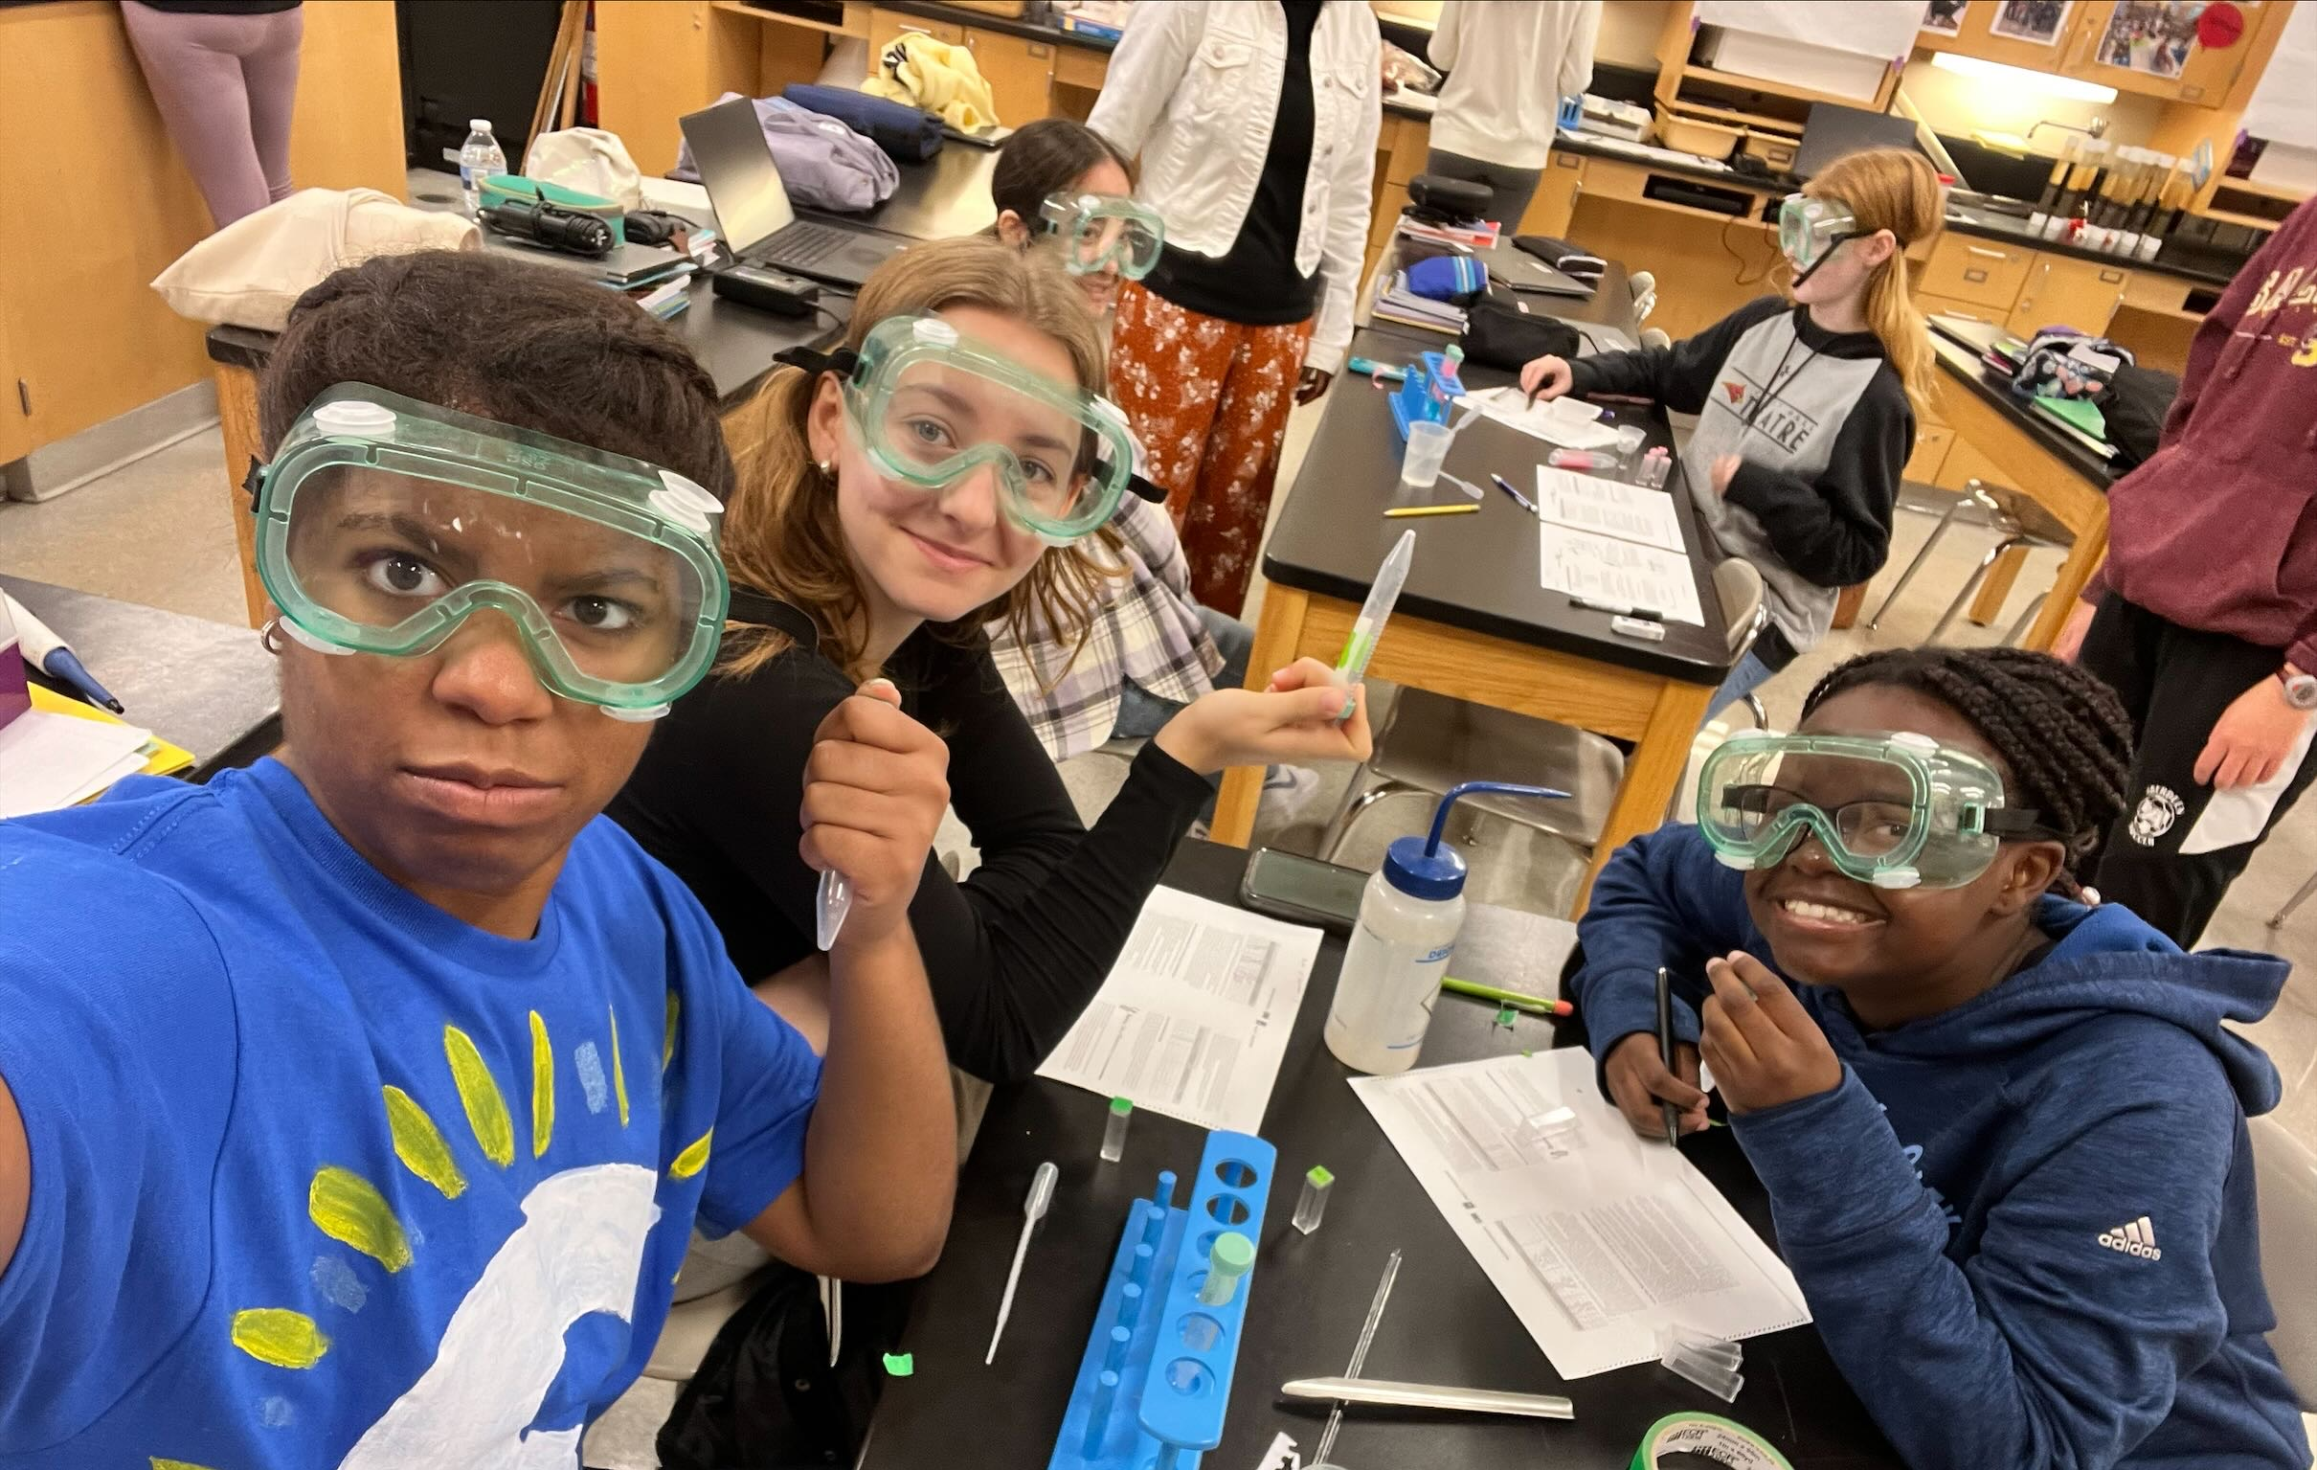
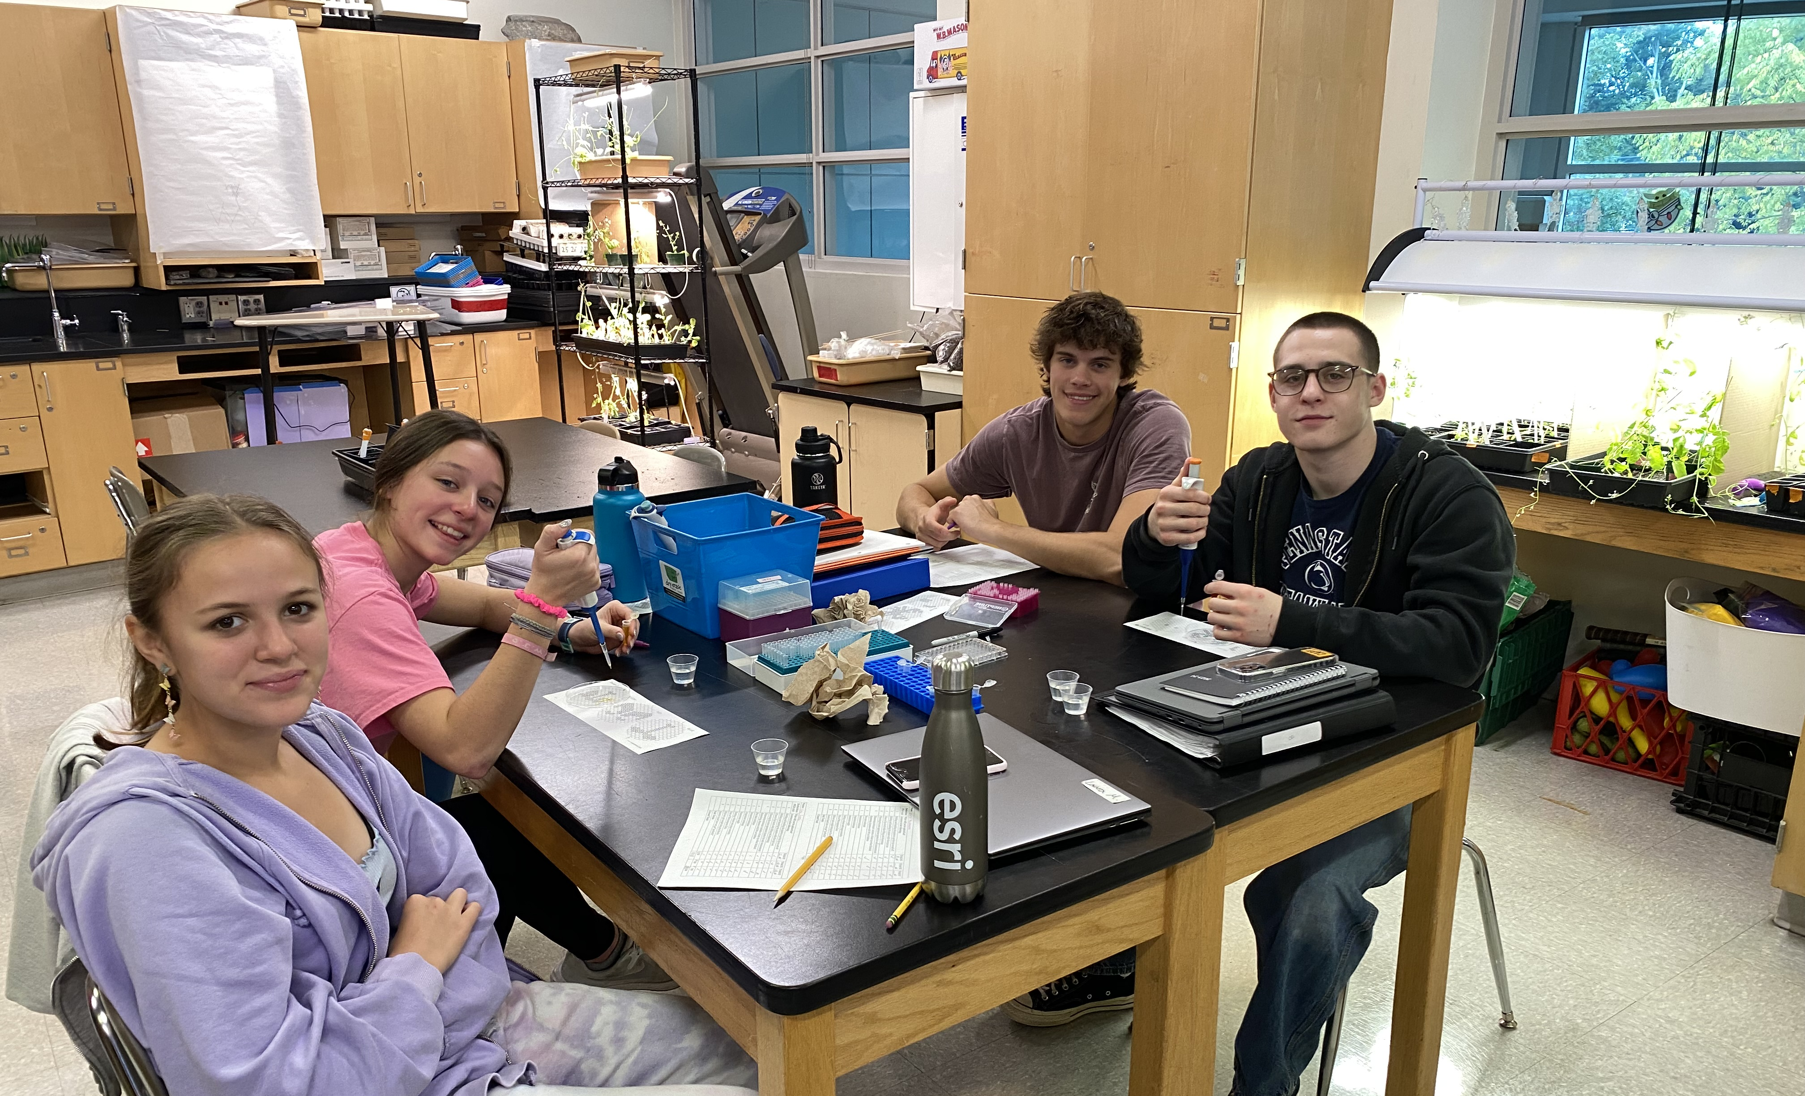
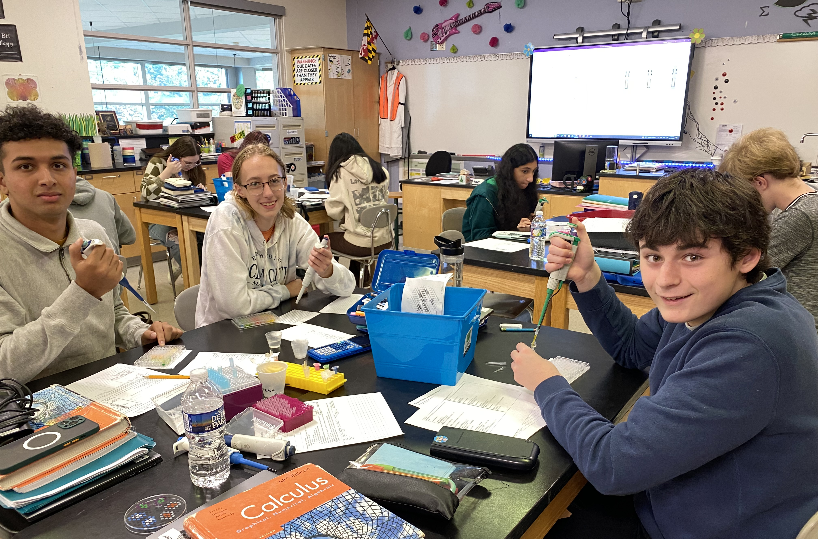
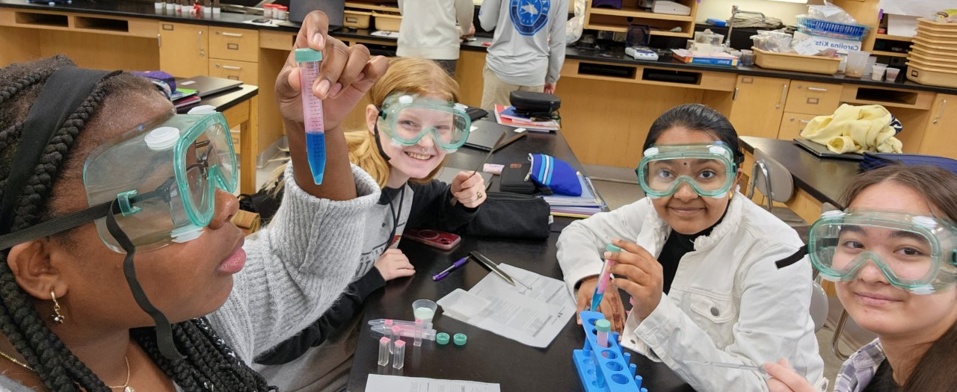

Slide 30
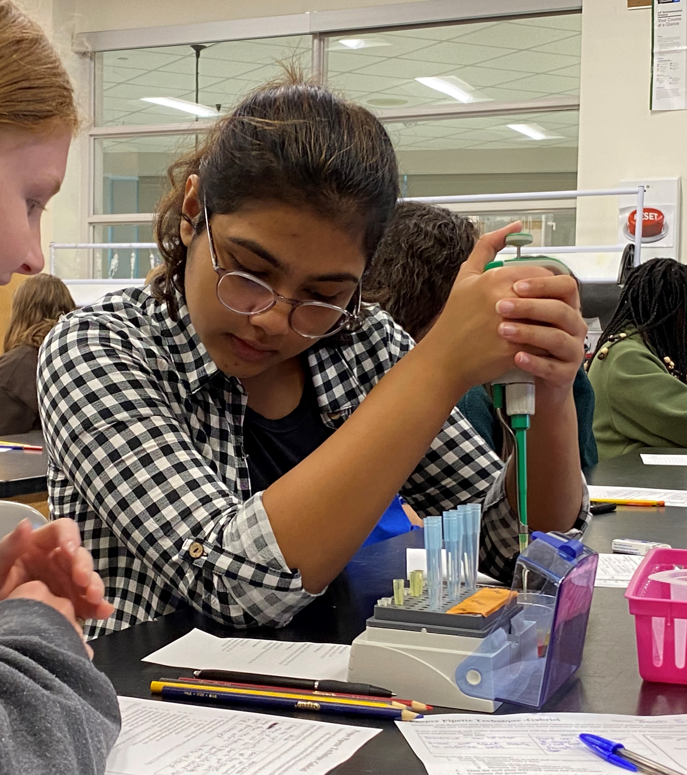
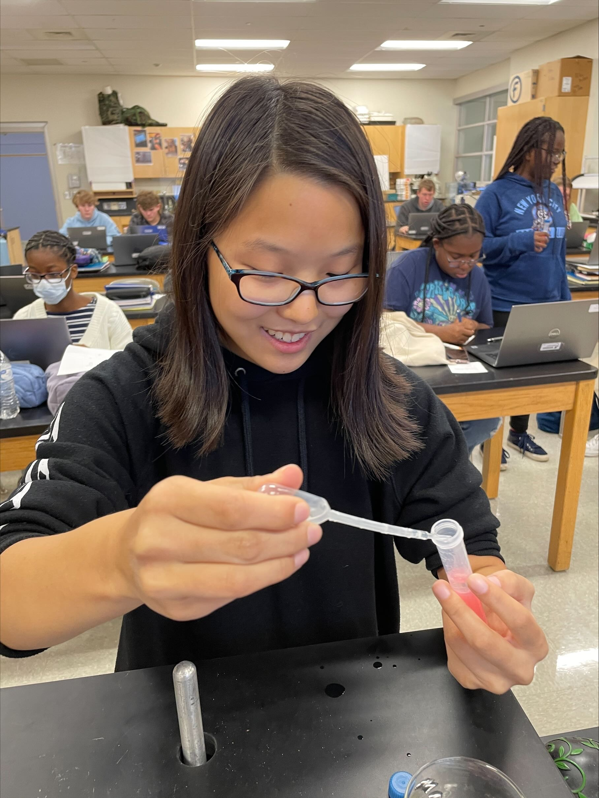
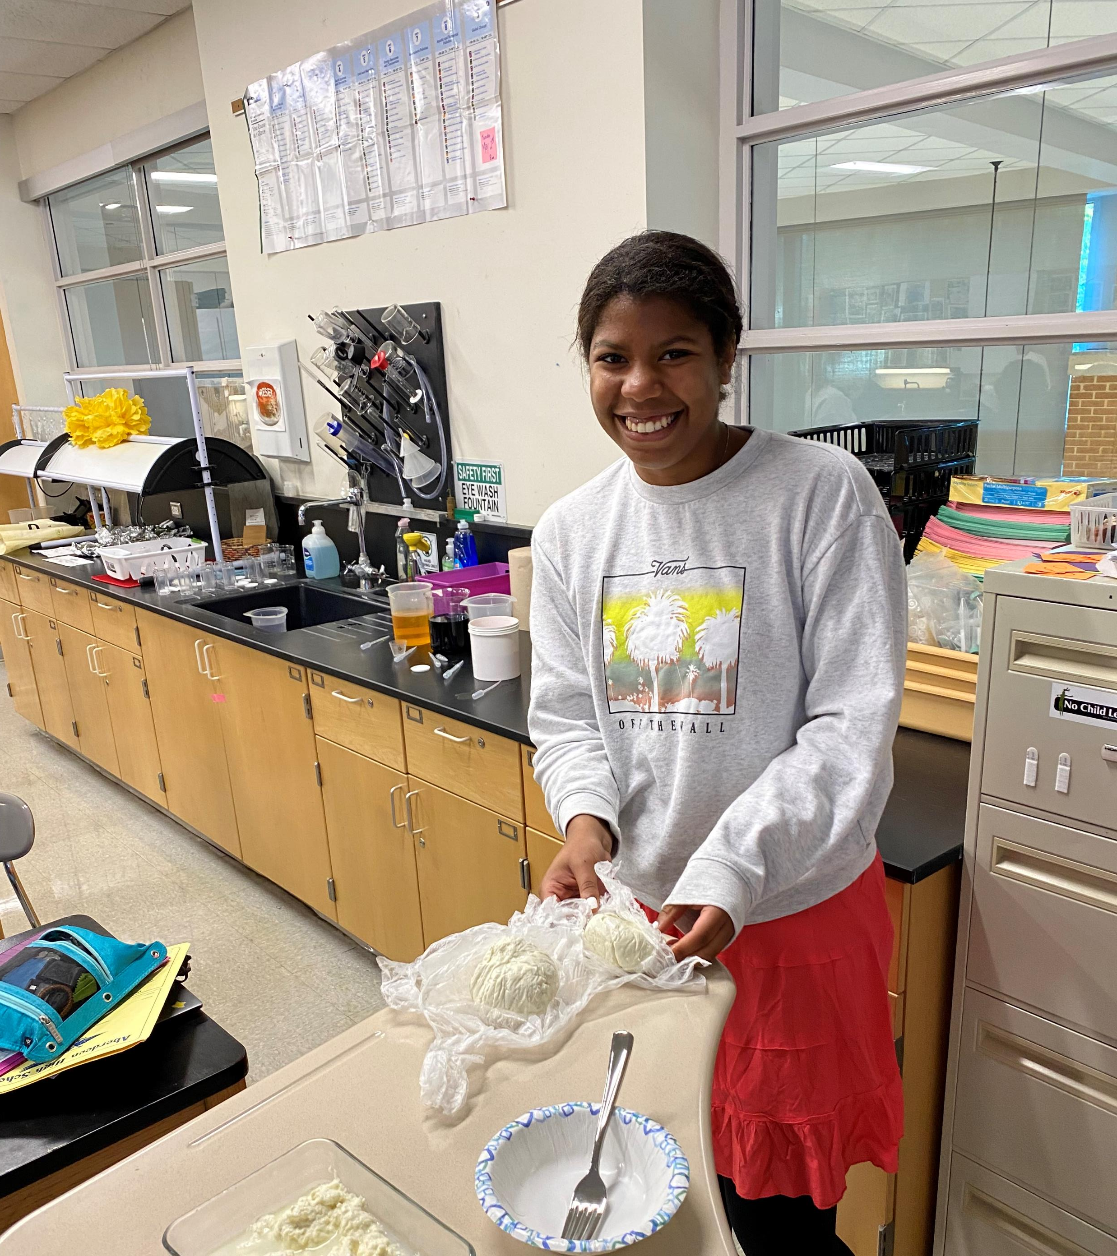
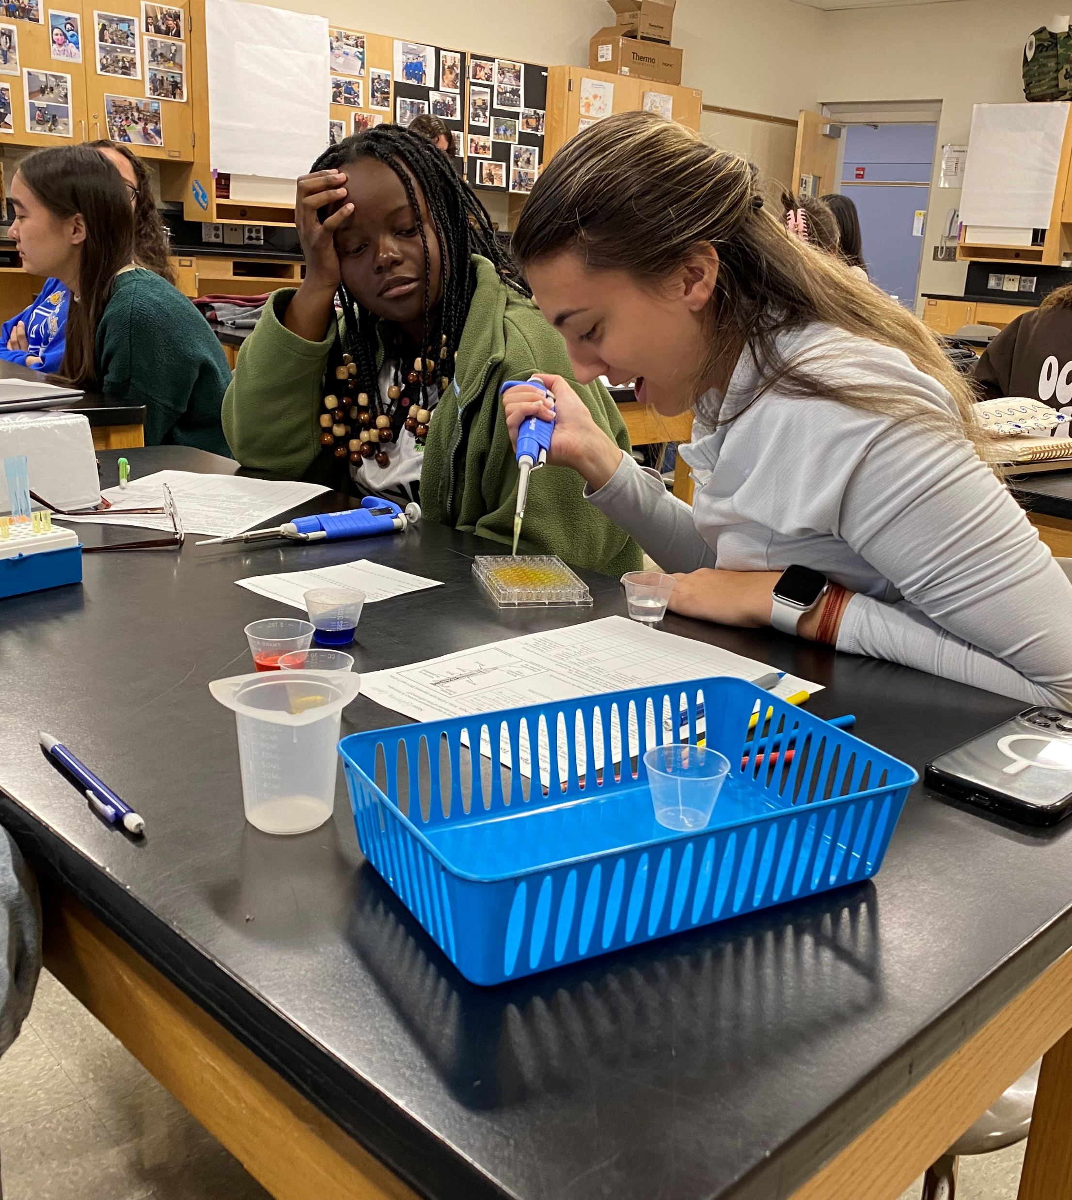




Slide 31

Math Logic
Practice in writing proofs (Direct, Indirect, Mathematical Induction and Counterexample)
Number and set theory
Division Algorithm
Ordinary Differential Equations of order one and two.
A blend of theory, application, and computation.
Enrollment is Calculus is required!

Slide 32







Zoology
Evolution of animals
Phylogenetic relationships
Anatomy and physiology organisms in the Kingdom Animalia
but also...
dissections!

