Slide 1
Science and Mathematics Academy
Pre-Course Selection Presentation
2026-2027 Options

Slide 2
Course Selection
Timeline
Today - Receive Course Selection sheet
Next week - Talk to Your Teacher and Your Parents
Schedule an appointment with Your School Counselor or Mrs. Ashley, if needed
Bring back completed sheet
Remember you need 8 credits for next year

Slide 3
Disclaimers
Register for the classes you want…not what you think will “fit” based on this year’s schedule
There is a new committee working on the Master Schedule this year – classes will be based on the “Conflict Matrix”
  30 students sign up for Class X and 12 of those also sign up for Class Y -> the committee would not schedule classes X and Y for the same spot
It is important to stick with what you pick during registration – because your choices dictate how the Master Schedule is organized

Slide 4
SMA AP Science and Math Courses
Biology
Physics C: Mechanics
Physics C: Electricity and Magnetism
Chemistry
Environmental Science
Calculus AB
Calculus BC
Computer Science A*
Statistics
Computer Science Principles (Does not satisfy any SMA requirements)
*Computer Science A – Open to all rising juniors and seniors. Rising sophomores must have A’s (quarter 1 and 2) in Algebra 2 to take the course in 10th grade.

Slide 5
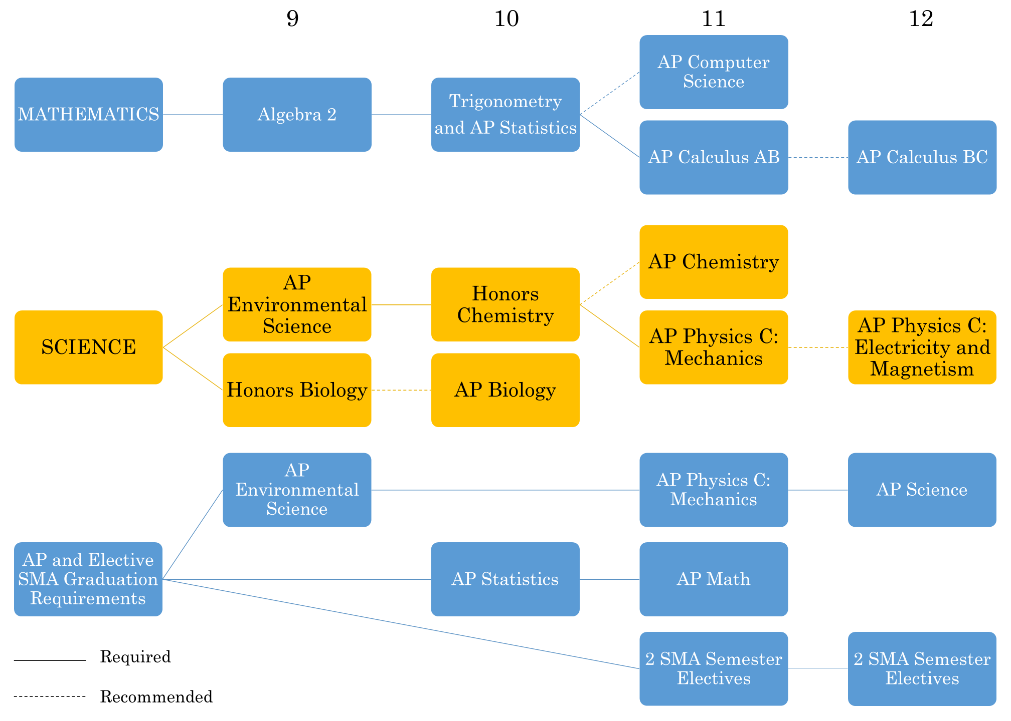
AP Precalculus and AP Statistics
AP Calculus AB
Total of 3 SMA Semester Electives

Slide 6
Summer PE?
I would NOT count on it coming back – instead, I would plan how to fit PE 9 (semester class) into your 10th OR 11th OR 12th grade schedule

Slide 7
Physical Education
Every student needs 1 credit of PE to graduate:
1 credit at AHS (full-year at AHS) = 1 credit
*you must register for PE 9 during 1st semester and a PE
of your choosing 2nd semester
½ credit at AHS of PE9 + 1 HCC class = 1 credit
Max of ½ credit at HCC (There are 4 HCC classes which fulfill this ½ credit. ONLY these 4 classes will earn credit – no other HCC class can be used).

Slide 8
HCC Courses: 5-week term
HCC Course Name | Course Number
Wellness (or Fitness) Walking *can be done 100% virtually! | PE 230
Circuit Fitness | PE 137
Advanced Weight Training | PE 229
Weight Training | PE 228
Only these 4 classes will earn you your ½ credit with HCPS. NO Substitutions. NO Exceptions.

Slide 9
Health 2
By graduation, you will be required to take a ½ credit (1 semester) course “Health 2” – this is a new MSDE Graduation Requirement
You will be required to take 3 SMA semester elective courses (instead of the previously required 4), but you can still take 4 if you plan and have the space!

Slide 10
Options to fit Health 2
Grade | Semester 1 | Semester 2
10th | PE 9* | Health 2
11th | SMA Elective | SMA Elective
12th | SMA Elective | SMA Elective
Fit Health 2 into your schedule in 10th grade = frees you up to take 4 SMA Semester Electives
*To earn your 2nd ½ credit of PE you could take virtual Wellness Walking @ HCC
Grade | Semester 1 | Semester 2
11th | SMA Elective | Health 2
12th | SMA Elective | SMA Elective

Slide 11
What if I still want to take 4 SMA Semester Electives, but don’t have room in 10th grade?
You can find/make room in grades 11/12!
Grade | Semester 1 | Semester 2
11th | PE* | Health 2
 | SMA Elective | SMA Elective
12th | SMA Elective | SMA Elective
*This could be PE 9 or PE 10/12 depending on your current PE status.
Grade | Semester 1 | Semester 2
11th | SMA Elective | SMA Elective
12th | PE* | Health 2
 | SMA Elective | SMA Elective
*To earn your 2nd ½ credit of PE you could take virtual Wellness Walking @ HCC

Slide 12
HCPS Graduation Requirements
Subject | Credits Needed
Math | 4 (You must take a math class your senior year for State colleges in MD!)
English | 4
Science | 3
Social Studies | 3
PE | 1
Fine Art | 1
Health | 1
Technology | 1 (fulfilled by SRT 2)

Slide 13
Grade Ten
SMA Graduation Requirements:
3 SMA semester electives (paired with Health 2)
1 SMA AP Science beyond
SMA APES and SMA Physics Mechanics
SMA AP Calculus AB
SRT 1 - 4
SMA AP Precalculus | Honors English 2
SMA AP Statistics | SRT 2
SMA Honors Chemistry | Government or AP Government
Open (Suggested: Fine Art, Health 2/PE, World Language, AP course, or another elective) | Open (Suggested: Fine Art, Health 2/PE, World Language, AP course, or another elective)

Slide 14
For JUNIOR and SENIOR years ONLY!!!!!!!!
Fall 2026-2027 | Spring 2026-2027
Robotics | Microcontrollers
Organic Chemistry | Biochemistry
Kinesiology | Biotechnology
Pre-Engineering | Design Engineering/CAD
Linear Algebra | Intro to Mathematical Logic
Algorithm Development for Applications | Statistics using R
Bacteriology | Zoology
Bold font indicates the class is offered every other year
– Microcontrollers swaps with Cryptology

Slide 15
Grade Eleven
SMA Graduation Requirements:
3 SMA semester electives (paired with Health 2)
1 SMA AP Science beyond
SMA APES and SMA Physics Mechanics
SMA AP Calculus AB
SRT 1 - 4
SMA AP Calculus AB | English 3 or AP English
SMA AP Physics C: Mechanics | SRT 3
SMA Semester Electives (1 pair and or elective/health2) | World History or AP World History
Open (Suggested: Fine Art, Health 2/PE, World Language, SMA AP science course, or another elective) | Open (Suggested: Fine Art, Health 2/PE, World Language, SMA AP science course, or another elective)

Slide 16
Grade Twelve
SMA Graduation Requirements:
4 SMA semester electives
1 SMA AP Science beyond
SMA APES and SMA Physics Mechanics
SMA AP Calculus AB
SRT 1 - 4
Mathematics Credit (SMA AP Calculus BC or math elective pair) | SRT 4
English 12 or AP English | SRT 4
SMA Semester Elective Pair (or elective w/ Health2) | SMA AP Science (Bio, Chem or E&M)*
Open | Open

Slide 17

Senior Options
AVID Tutor
Apprenticeship
An AVID tutor is an active participant within the AVID classroom.
An AVID tutor consistently:
  Reports on time
  Conducts themselves in a professional manner
  Circulates around the classroom
  Assists students and classroom teacher with
    Lesson implementation
    Binder checks/organization
    Tutorial sessions
See Mrs. Nau to get more information
Earn a salary at an apprenticeship job and receive high school credits
Ensure you have enough credits to graduate
Related instruction aligned with apprenticeship
Resume (student submits)
Cover letter for the business of interest (student submits)
Application (student submits)
Complete 450 hours of paid work at apprenticeship by graduation
Students can earn hours junior year, summer leading into senior year, and senior year
See Mr. Pistel to get more information
Notes:
https://hccweb1.harford.edu/dualenrollmentcalculator/

Slide 18
Master Tutor: Credit Class – Seniors only!
Application due February 27th
Blank applications are in the Office of School Counseling (and emailed to you)
Work with students in a Math, Science, English, or Social Studies class
Provide support to students in the classroom
Serve as a positive role model
Tutor students
Provide encouragement
Work with the classroom teacher to ensure student success
Can be turned in directly to Mrs. Ashley or the bin in the Office of School Counseling
Not on course selection sheet. Must have an approved application.

Slide 19
HCC and Workforce Development Options – Juniors and Seniors
Refer to the grade level AHS Office of School Counseling PPT

Slide 20
Apprenticeship – Rising Seniors Only!
Earn a salary at an apprenticeship job and receive high school credits
Ensure you have enough credits to graduate
Related instruction aligned with apprenticeship
Resume (student submits)
Cover letter for the business of interest (student submits)
Application (student submits)
Complete 450 hours of paid work at apprenticeship by graduation
Students can earn hours junior year, summer leading into senior year, and senior year
See Mr. Pistel to get more information
Notes:
https://hccweb1.harford.edu/dualenrollmentcalculator/

Slide 21
Next Steps
Make sure you have met (or have a plan to meet) all graduation requirements
Complete your course selection sheet in preparation for course selection.
Still have questions?
  Talk to your current teachers
  Talk with your parents
  Talk to a reliable upperclassman
  Talk to Mrs. Ashley
  Make an appointment with your School Counselor

Slide 22
Aberdeen High School Counseling Staff
Ms. Farthing (A - Da)
Angela.Farthing@hcps.org
Mrs. Manning-Gohlinghorst (De - Ha)
Elizabeth.ManningGohlinghorst@hcps.org
Dr. Devearl Royster(He - Me)
Devearl.Royster@hcps.org
Mrs. Humphreys (Mi - Sh)
Kimala.Humphreys@hcps.org
Ms. Joyce (Si – Z)
Hannah.Joyce@hcps.org
Mrs. Smallwood (Registrar)

Slide 23
Registration during SRT/Health 9
Classes will be called down to the Media Center: January 26th – February 13th
You will meet with your school counselor one-on-one to input your schedule.

