Slide 1
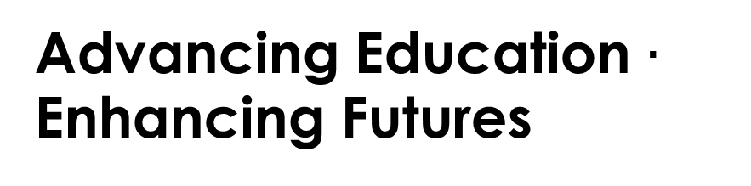
Mrs. Erica Harris, Principal of AHS
Mrs. Sarah Ashley, SMA Program Specialist

Slide 2
Reminders
Bathrooms are located on your left as you exit the auditorium
In the event of an emergency, please exit the building via the closest exterior door – look for the green exit signs – and proceed to your car in the parking lot
When we receive an all clear we will bring everyone back into the building (if applicable)

Slide 3

Welcome

Slide 4
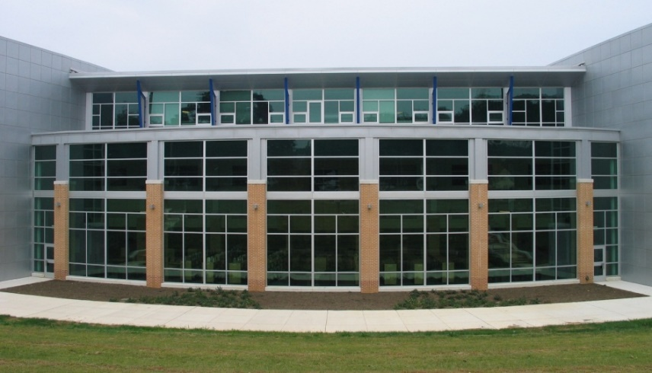
Our Goals
 |  | To prepare students to succeed in any STEM Major in college (Engineering, Math, Science, CS). To challenge students to problem solve and become independent self-reliant learners. | To prepare

Slide 5

SMA Faculty
Mr. Mark Evans – Mathematics
Mrs. Yvonne Gabriel – Science
Mr. Mike Homishak – Science
Ms. Diana Liberto – Mathematics
Mr. Tim Polack - Mathematics
Mr. Jason Sherid – Science
Mr. Aaron Simmons – Science
Mr. Andrew Webster – Mathematics
Mrs. Sarah Ashley – Program Specialist

Slide 6
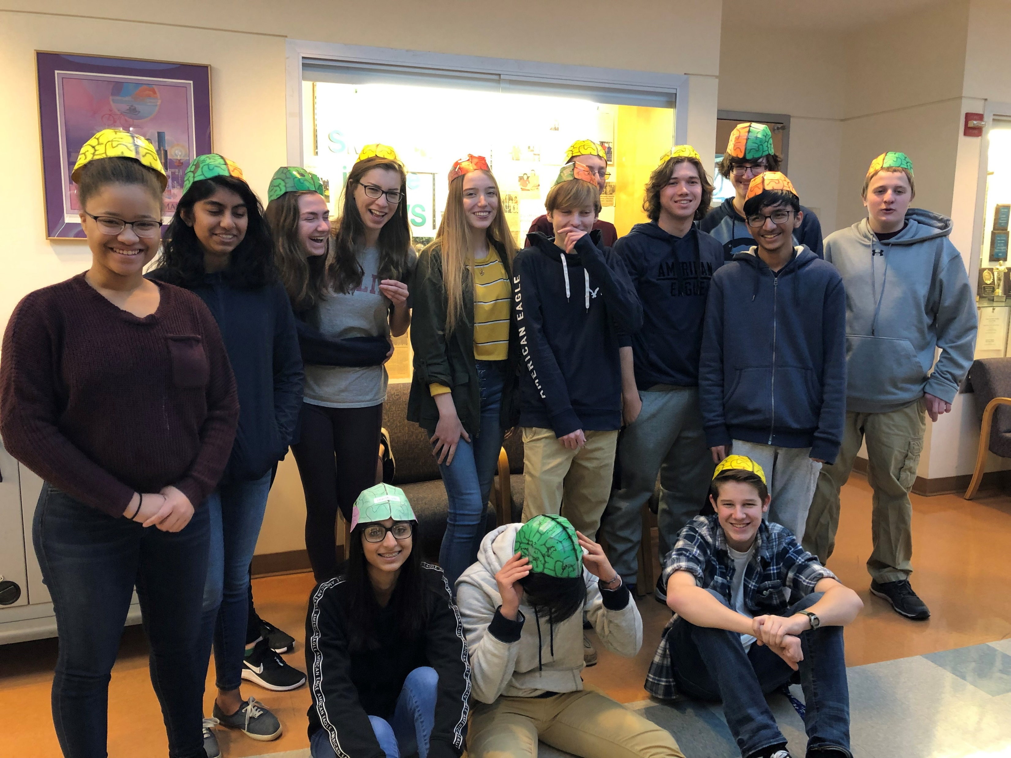
SMA Student Body
183 students currently enrolled
representation from all HCPS middle schools as well as several private schools

Slide 7
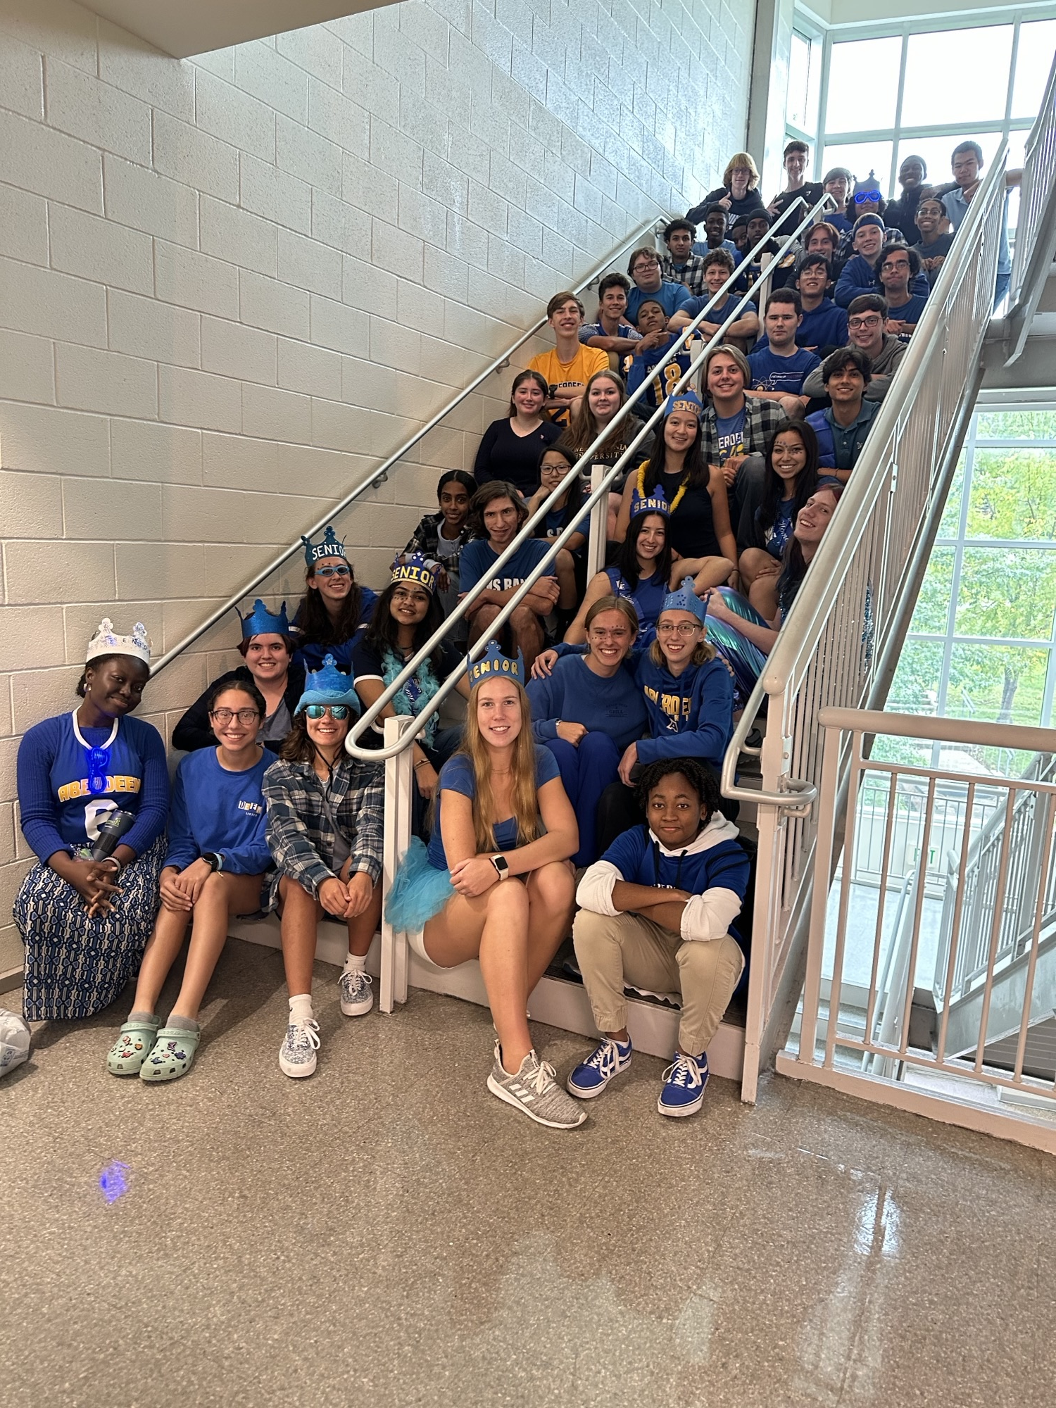
Myth #1
SMA students don’t have time to participate in sports, art, clubs, or music!

Slide 8
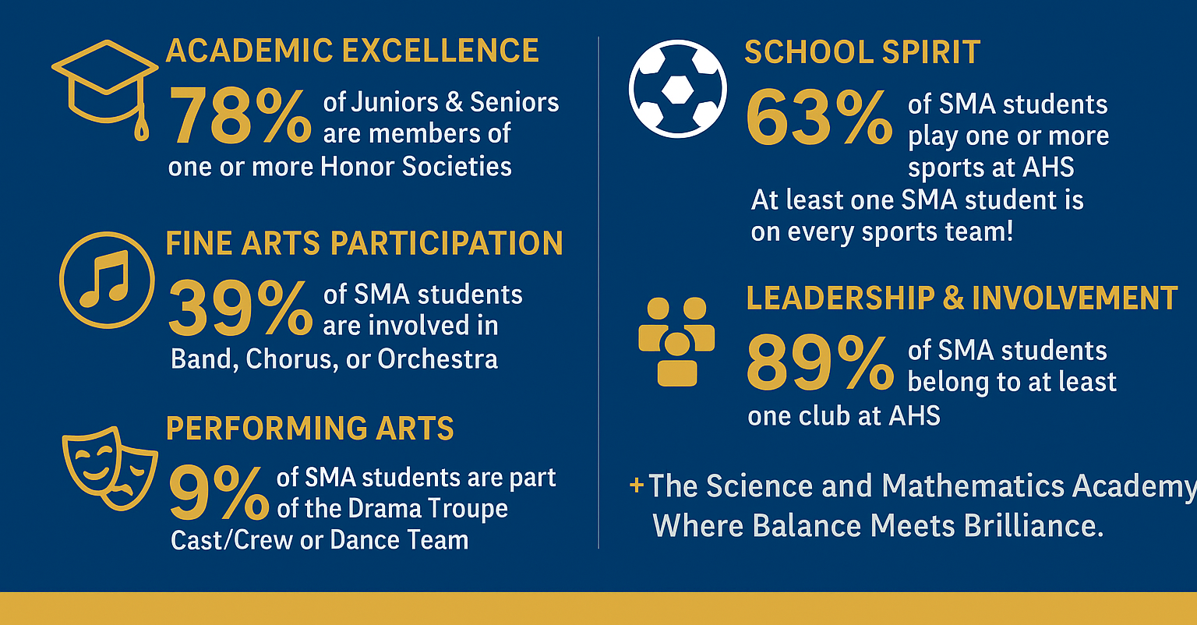
Beyond the Classroom – Our student excel everywhere!

Slide 9
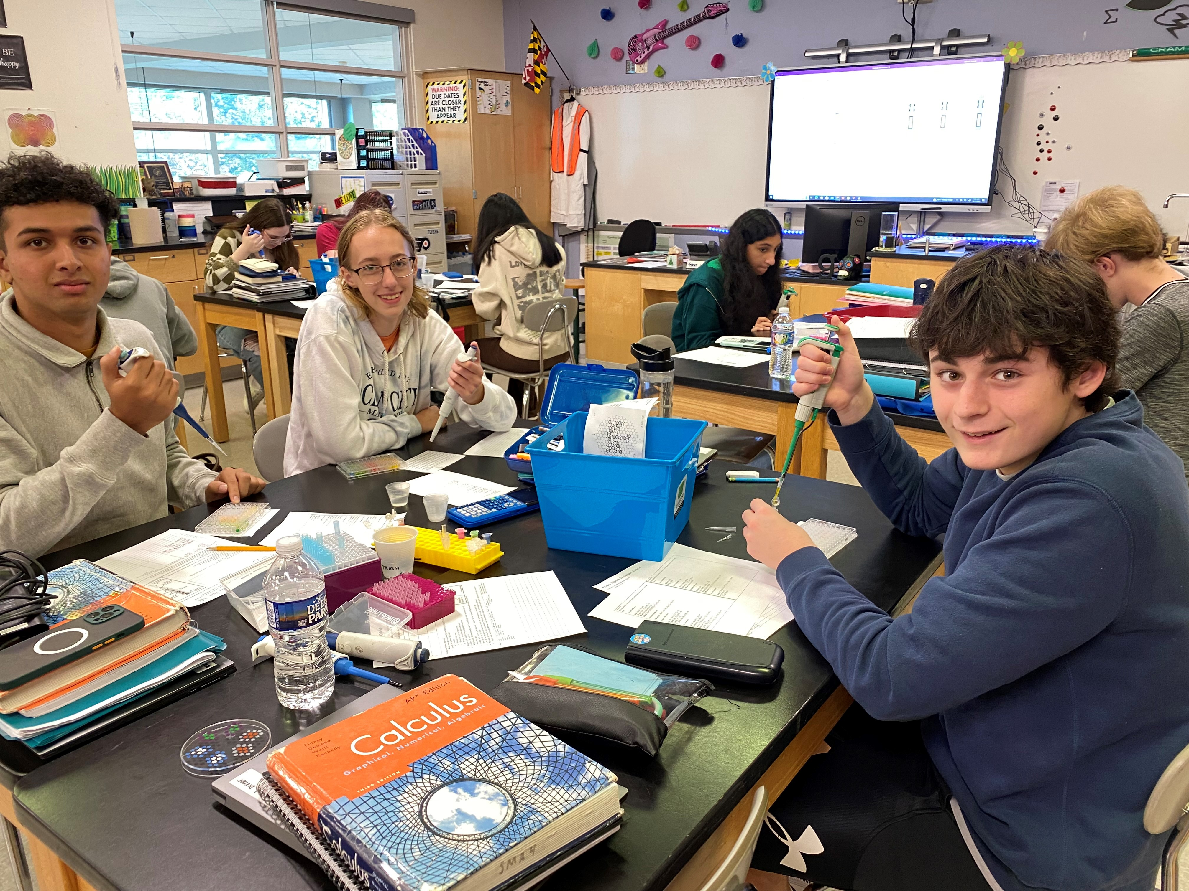
Myth #2
It is impossible to continue to earn high marks in such challenging classes!

Slide 10
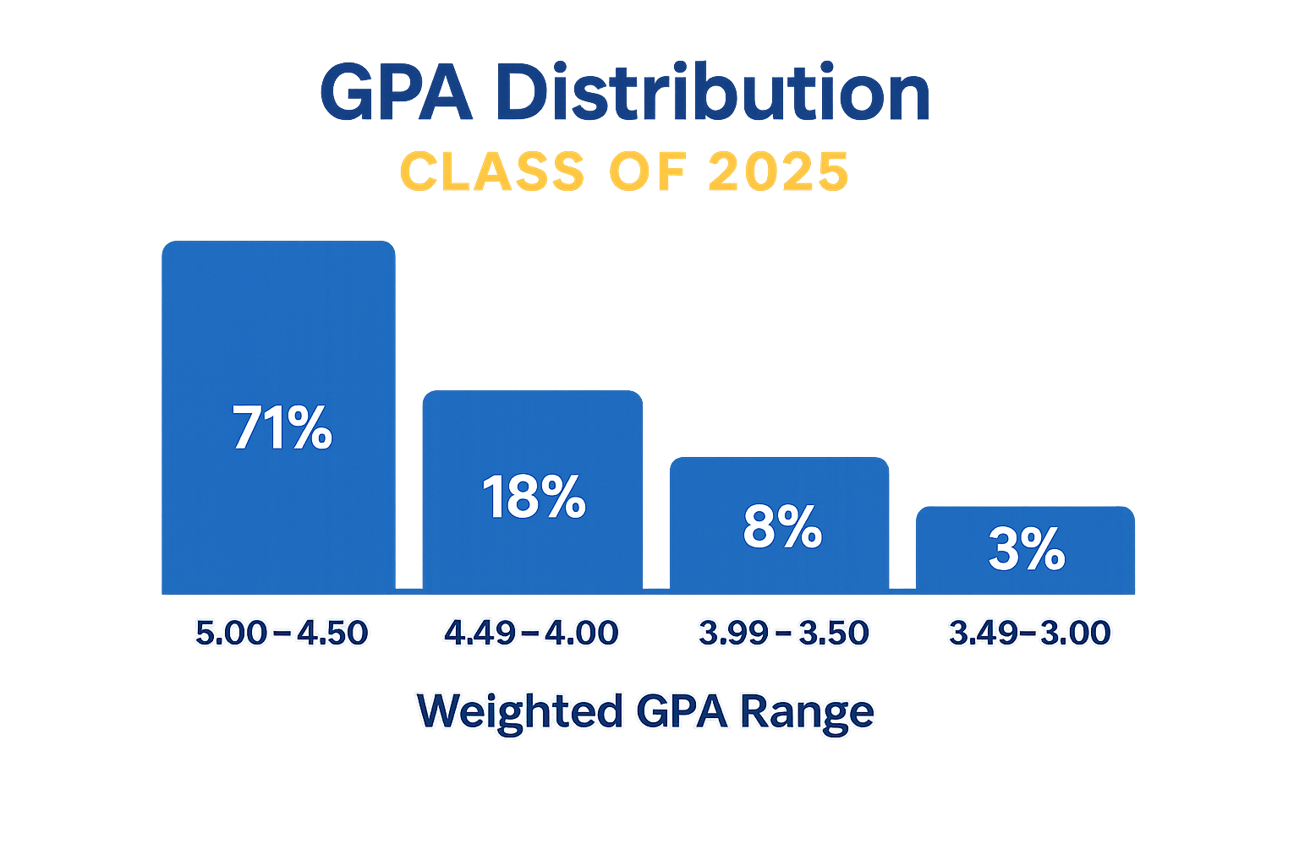

Truth: Accomplishments
College Scholarships: Over $9.1 million

Slide 11
AP Scores 2024-25
Course | SMA Average Student Score | SMA % Passing (3+) | Global % Passing (3+)
Calculus AB | 4.32 | 89 | 64
Calculus BC | 4.43 | 97 | 79
Statistics | 3.80 | 90 | 60
Computer Science A | 4.58 | 100 | 67
Biology | 4.07 | 100 | 70
Chemistry | 4.00 | 100 | 78
Environmental Science | 4.28 | 98 | 69
Physics C: Mechanics | 2.86 | 61 | 72
Physics C: Electricity and Magnetism | 3.59 | 76 | 72
Exams are scored on a 1-5 scale

Slide 12
Myth #3
From the moment you get home until the moment you go to bed (late at night) all you have time for is homework.
There will be times when you are busy. The students who handle the workload best are ones that plan ahead, stay organized, ask for help, and remove distractions. We prioritize mental wellness in the SMA and help students build lifelong strategies to balance work and fun.
Truth

Slide 13

Myth #4
SMA students lack social skills/friends.
Just like with any group of people, SMA students have similarities and differences. They have friends in an out of the program. They are mathletes, athletes, and everything in between. The best part – you will be with a group of students who love to learn and explore!
Truth

Slide 14
Myth #5
Major | % of SMA grads
Animal Science/Veterinary | 1%
Biochemistry | 5%
Biology/Pre-med/Nursing/PT | 17%
Chemistry | 11%
Architecture | 4%
Engineering (Aerospace, Biomedical, Electrical, Mechanical, Chemical, Civil, General) | 28%
Computer Science/Engineering | 12%
Environmental Science | 2%
Materials Science | 2%
Mathematics | 6%
Physics | 3%
Psychology | 3%
Visual Arts or Music or Dance | 4%
The SMA is for students who want to be Engineers (and nothing else).

Slide 15
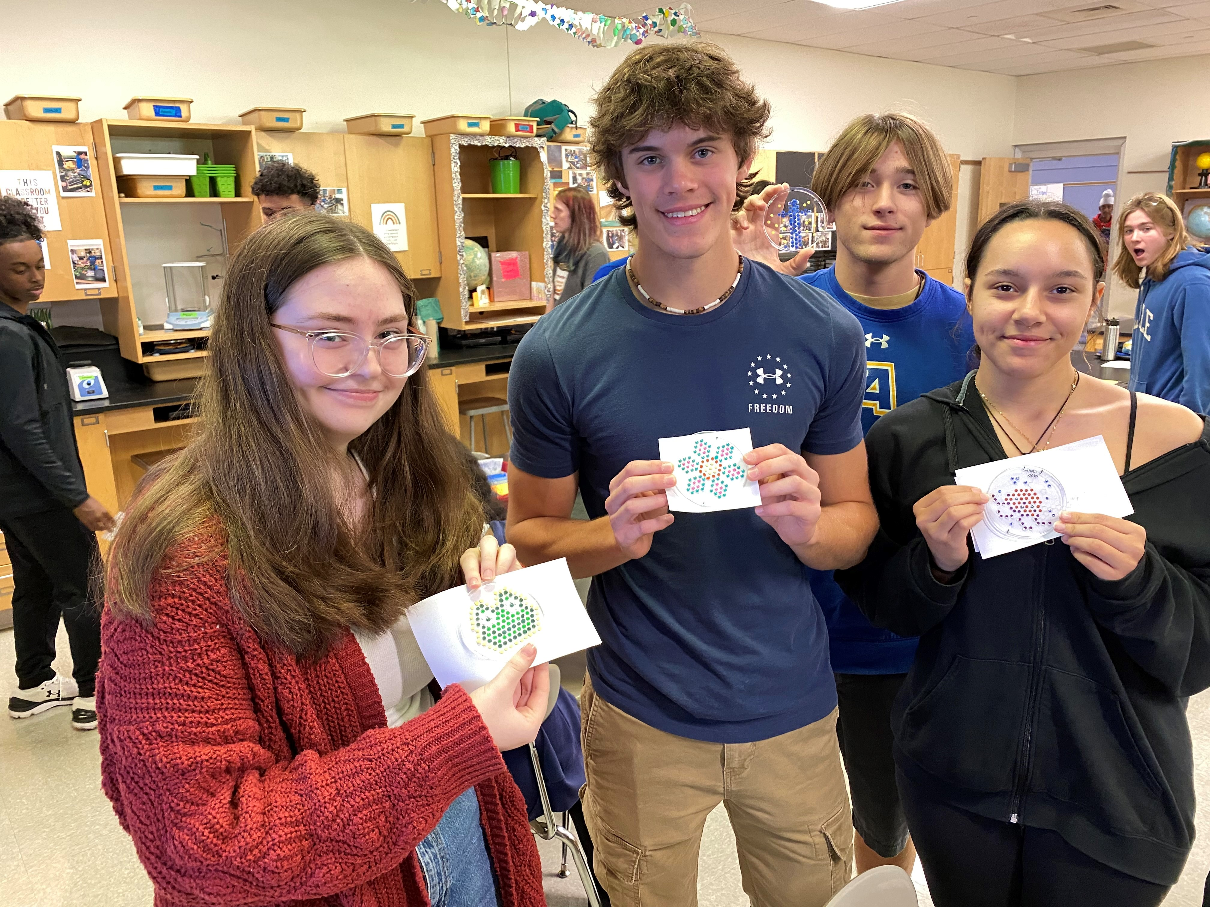
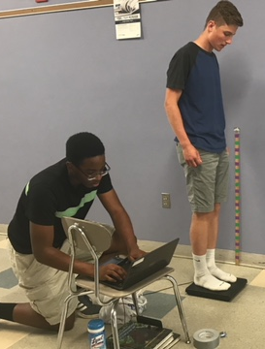
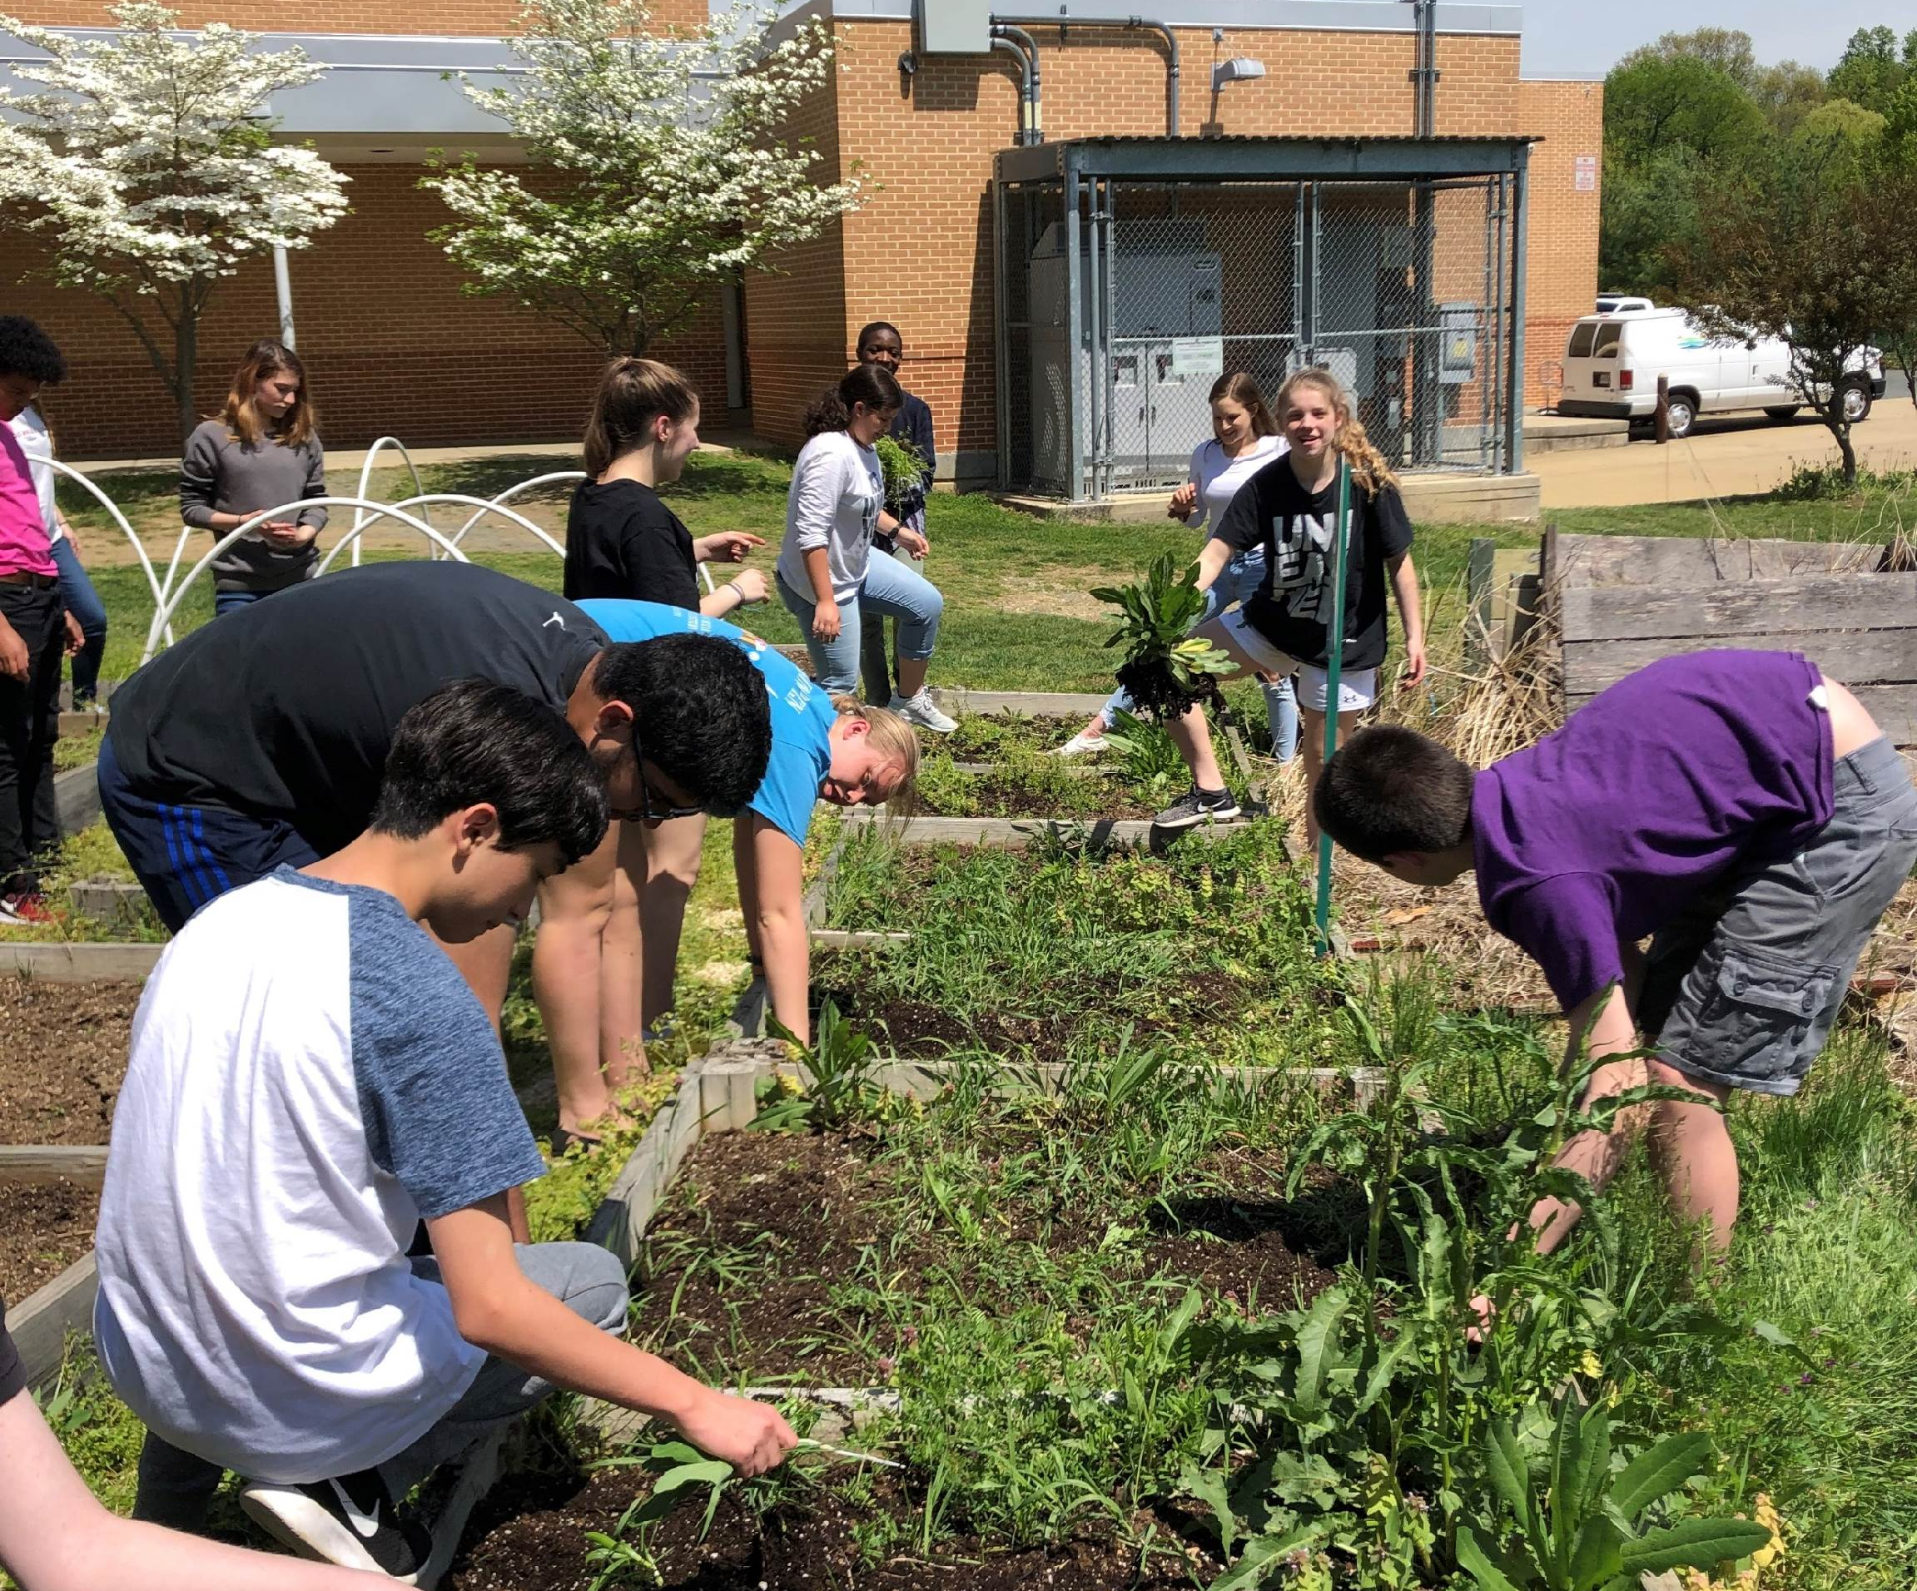
What makes the SMA unique?
Beyond our semester science and mathematics electives and AP courses infused with additional rigorous content…
we offer Science, Research, and Technology (SRT)

Slide 16
Advanced Science and Mathematics Semester Electives (based on student and faculty interest)
Algorithm Development for Applications
Bacteriology
Biochemistry
Biotechnology
Cryptology
Design Engineering
Kinesiology
Linear Algebra
Mathematical Logic
Microcontrollers
Organic Chemistry
Principles of Engineering
Research Design in STEM
Robotics
Statistics using R
Zoology

Slide 17
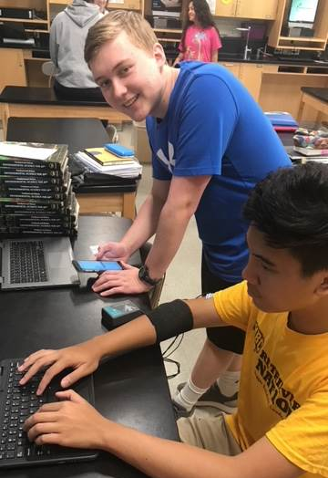
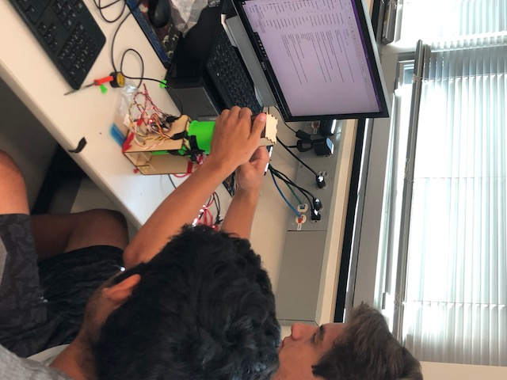
AP Science and Math Courses
Biology
Chemistry
Environmental Science (9th grade)
Physics: Mechanics (11th grade)
Physics: Electricity and Magnetism
Calculus AB (11th grade)
Calculus BC
Computer Science A
Computer Science Principles
Statistics (10th grade)

Slide 18
AP Courses beyond STEM
AP English Language and Composition
AP English Literature and Composition
AP US History
AP World History
AP Government
AP African American Studies
AP Spanish, French, and German
AP Advanced Studio Art

Slide 19
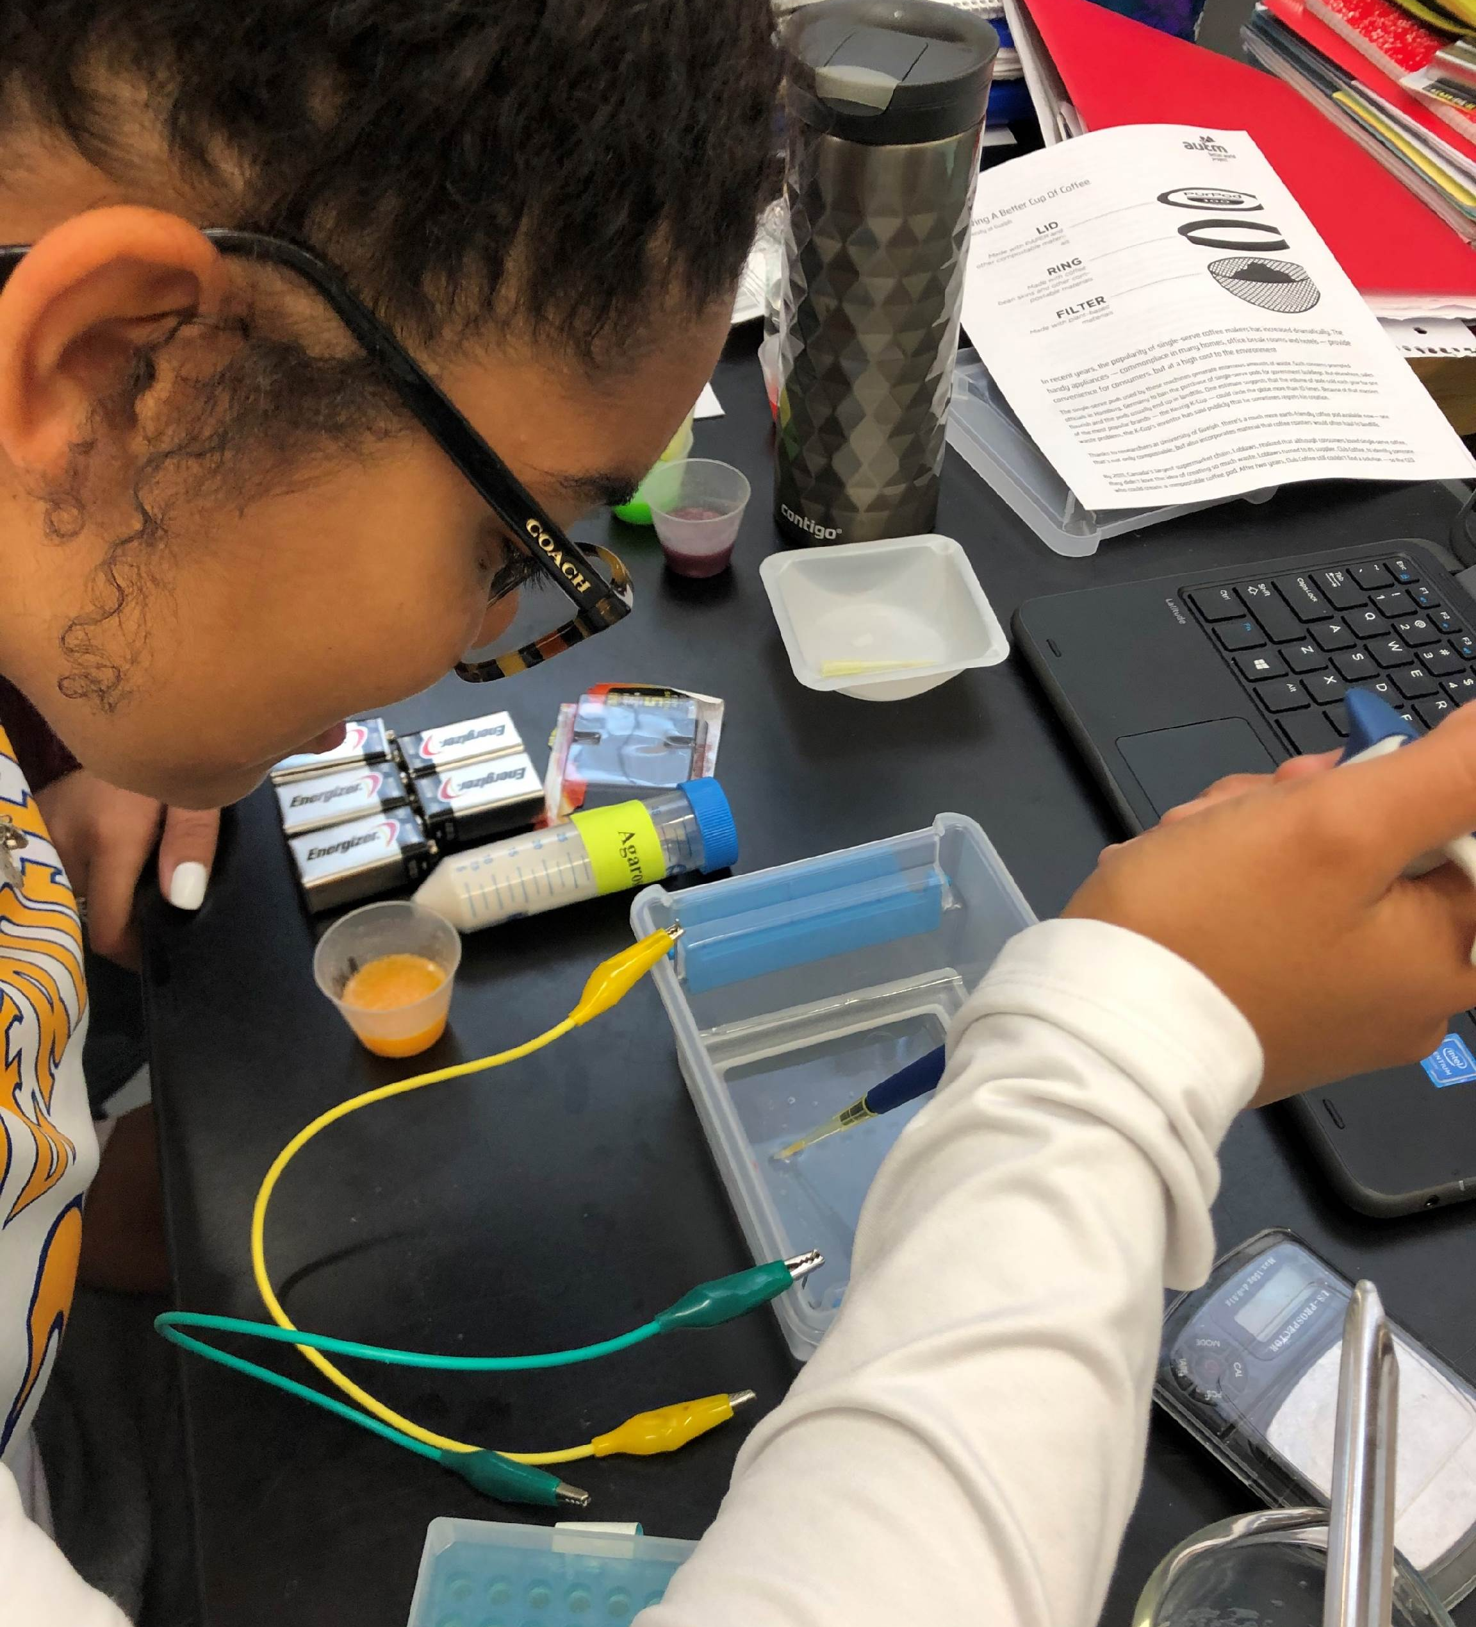
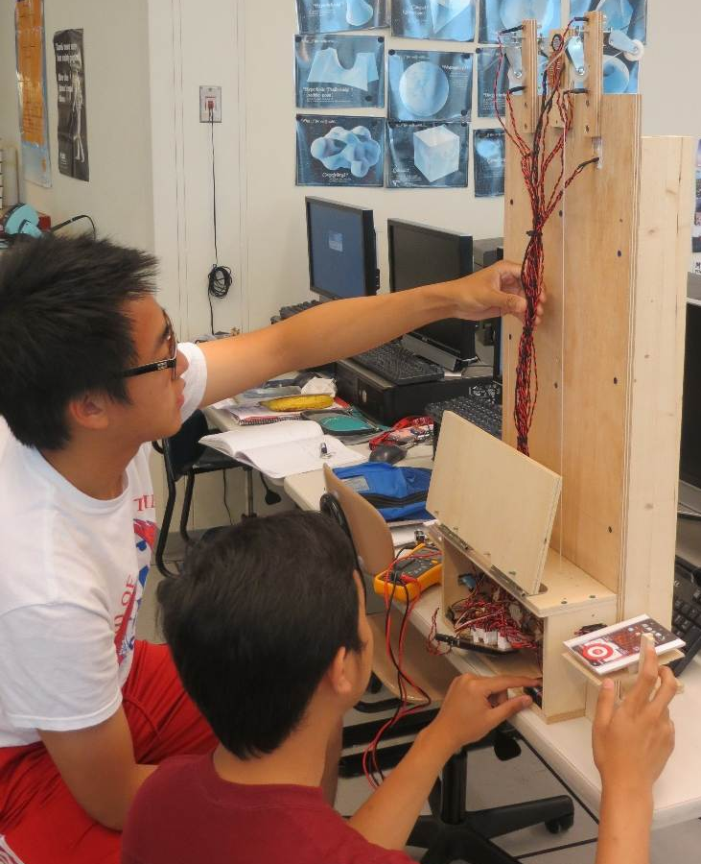
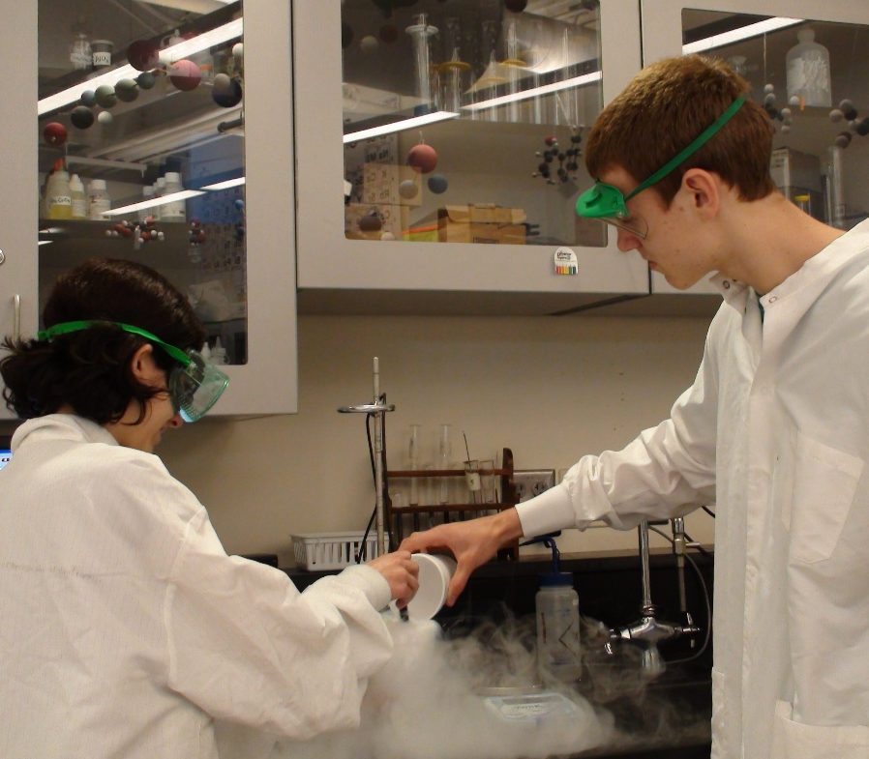
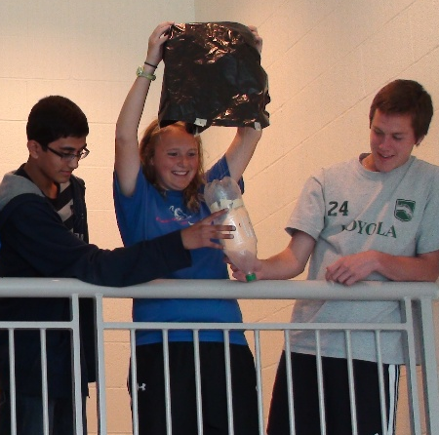
Science, Research, and Technology (SRT)
4-year sequenced series of courses STEM curriculum
Project-based
Relevant and authentic research

Slide 20
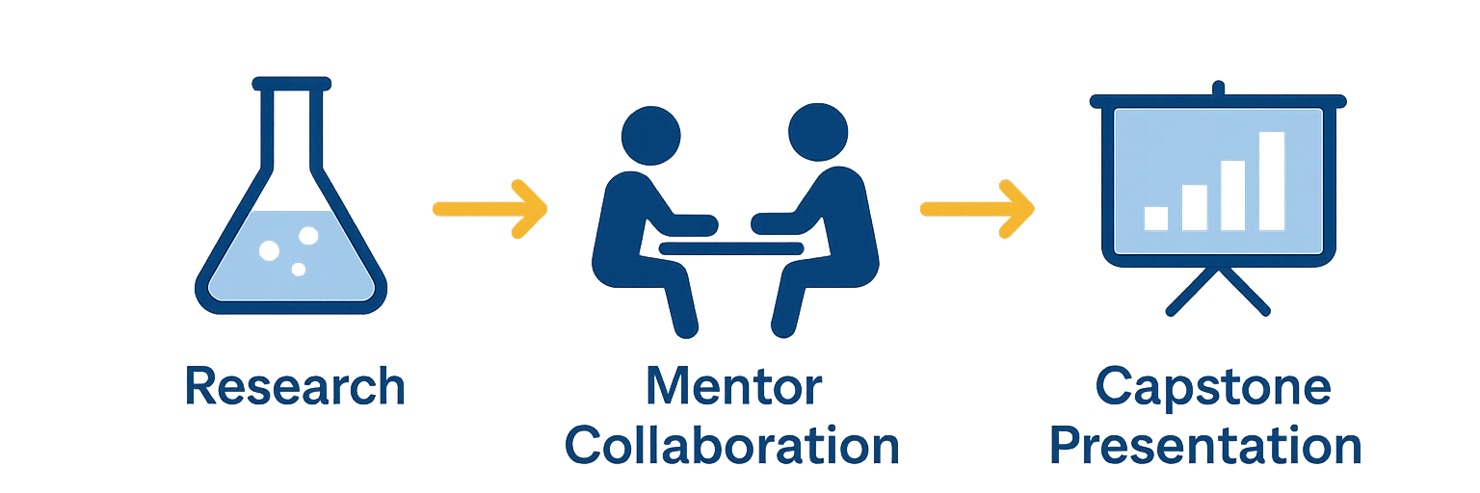
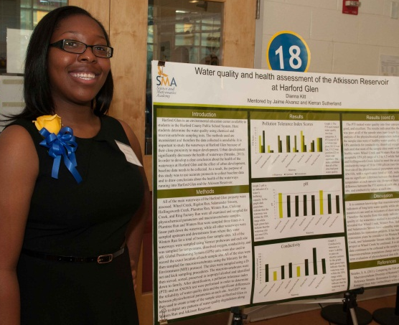
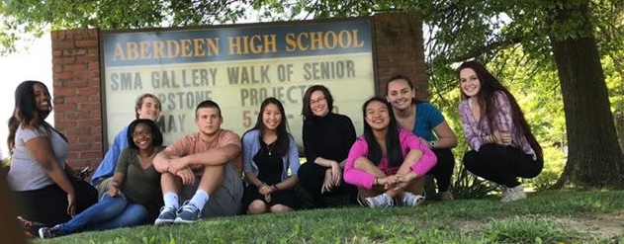
SRT – Senior Capstone Research Project

Slide 21
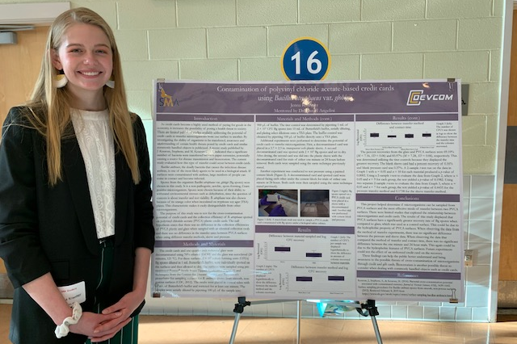
Capstone Partners
Becton Dickinson
Booz Allen Hamilton
CACI
Chesapeake Systems Engineering
Environmental Protection Agency
Focused Ingenuity
Kinzinger Farm
McLaughlin Physical Therapy and Hand Rehabilitation, Inc.
Pall Corporation
Pepco Holdings
Raytheon
The Hydrofarm Inc.
U.S. Army - DEVCOM Analysis Center
U.S. Army Aberdeen Test Center
U.S. Army C5ISR Center
U.S. Army DEVCOM CBC
U.S. Army DPW Environmental Division
U.S. Army Medical Research Institute of Chemical Defense
U.S. Army Public Health Center
U.S. Army Research Laboratory

Slide 22
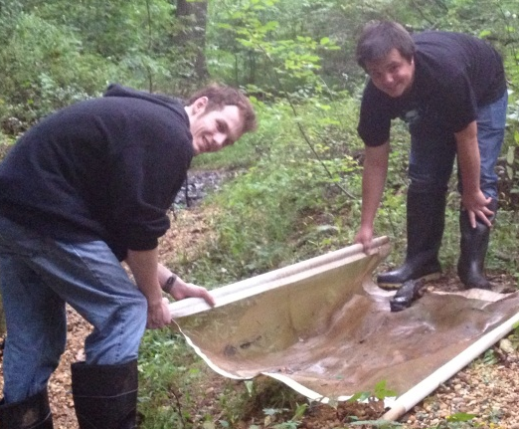
Program of Study
All SMA classes (bold) are taught by one of the 8 SMA dedicated faculty members and are in the SMA (3rd floor of AHS) and are ALL WEIGHTED CLASSES!
9th | 10th
SMA Honors Algebra 2 SMA AP Environmental Science SMA Honors Biology SRT 1/Health Honors English 9 AP US History Band/Chorus/Orchestra/Art World Language | SMA Trigonometry SMA AP Statistics SMA Honors Chemistry SRT 2 Honors English 10 World History (AP or standard) Band/Chorus/Orchestra/Art World Language
11th | 12th
SMA AP Calculus AB SMA AP Physics: Mechanics SRT 3 SMA Semester Electives English 11 (AP or standard) Government(AP or standard) Band/Chorus/Orchestra/Art World Language/Elec. | Mathematics SMA AP Science SRT 4 (2 credits) SMA Semester Electives English 12 (AP or standard) Band/Chorus/Orchestra/Art World Language/Elec.

Slide 23
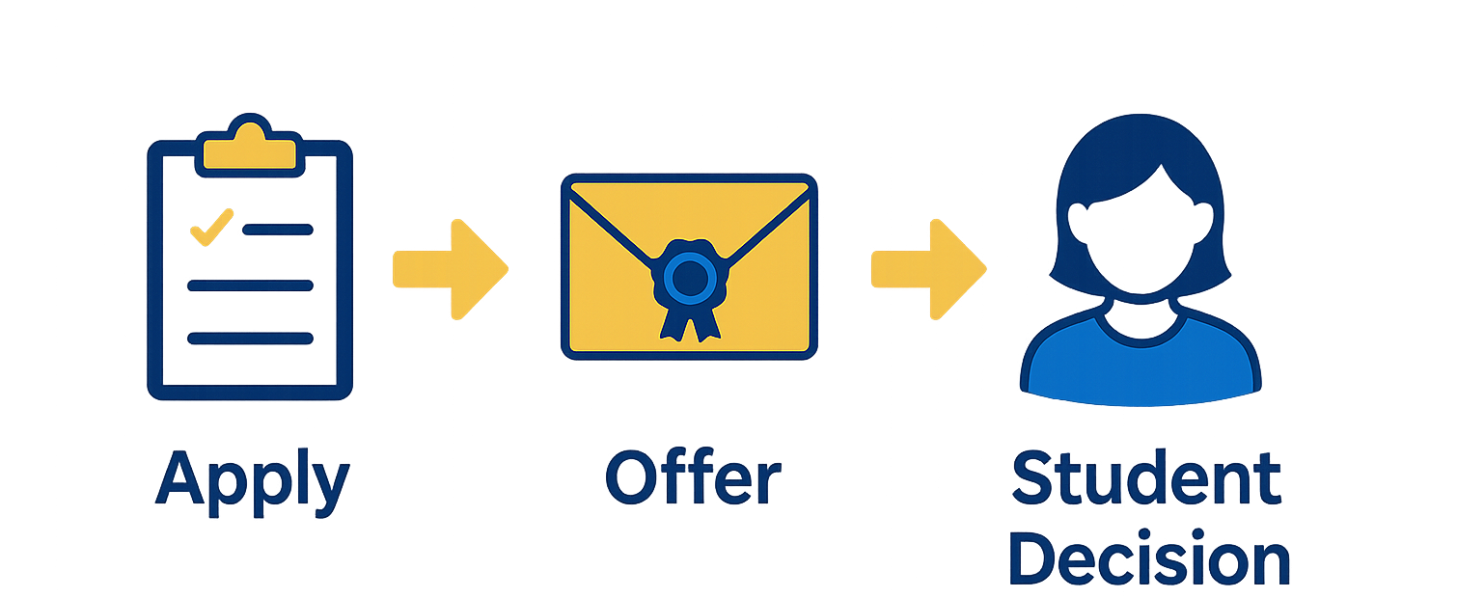
Online Application Timeline
December 3
February 6
March 1
All admissions communications will be done via email. Please ensure that the Student AND Parent email addresses you provide on the online application are accurate and checked frequently.

Slide 24
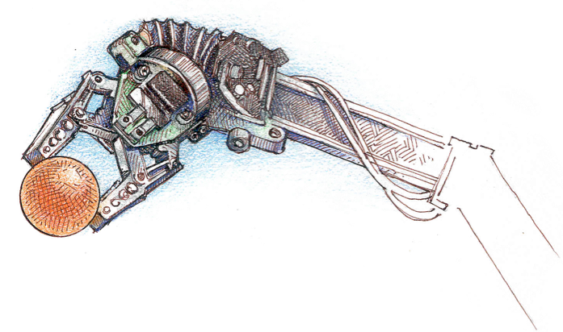
Selection Criteria
Level of academic achievement in middle school
Demonstrated interest and motivation for learning, especially in science and math
Written communication skills
Teacher Endorsements: 8th grade Science and Mathematics Techers

Slide 25
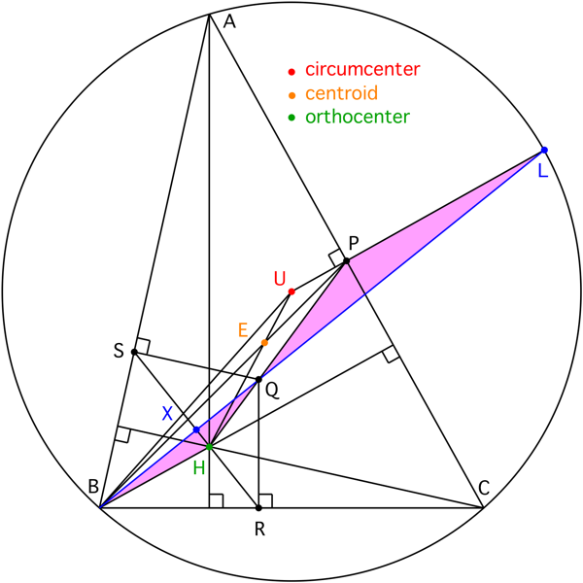
Mathematics Requirement
If you in 8th grade and are…
  currently enrolled in Geometry you will take Algebra 2 in 9th grade
  currently enrolled in Algebra 1 you can still be accepted into the SMA, but…
  You will be required to take BOTH Algebra 2 and Geometry during your 9th grade year.
SMA Honors Algebra 2
Geometry
SMA AP Environmental Science
SMA Honors Biology
SRT 1/Health
Honors English 9
AP US History
Band/Chorus/Orchestra/Art OR World Language

Slide 26
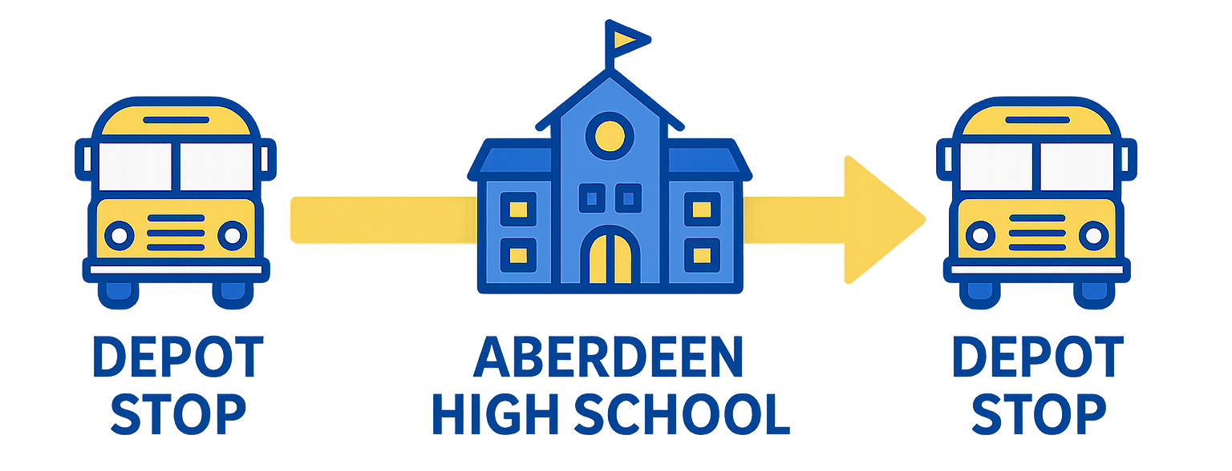
Transportation
Students outside of the AHS attendance district will utilize depot bus stops.
Each high school in the county serves as a depot bus stop. Afternoon stops also include all public library branches
HCPS does not provide busses home for students who stay afterschool for clubs/sports.

Slide 27




Science and Mathematics Academy Class of 26'
Student Perspectives
PRESENTED BY SHREEYA SHAH & JACK NEWBERRY

Slide 28

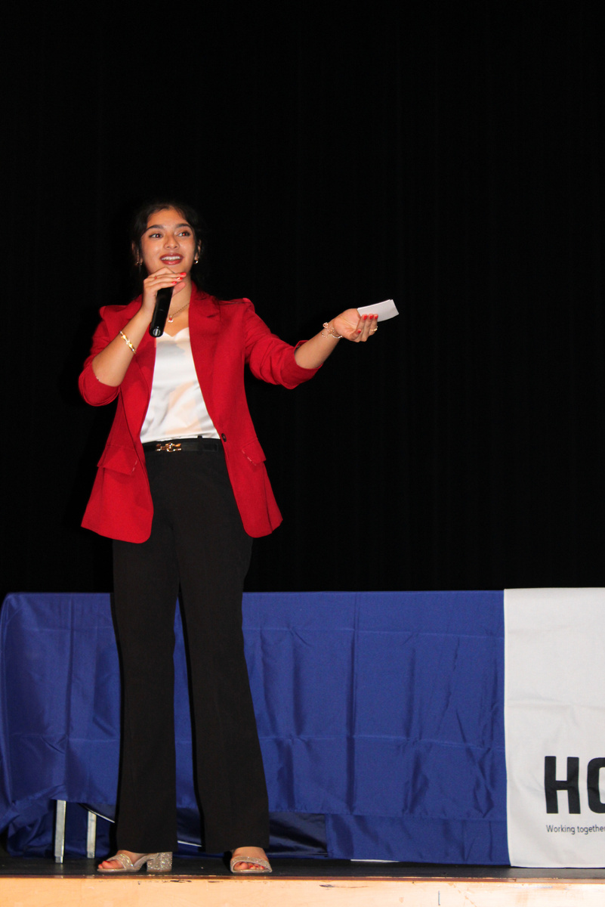
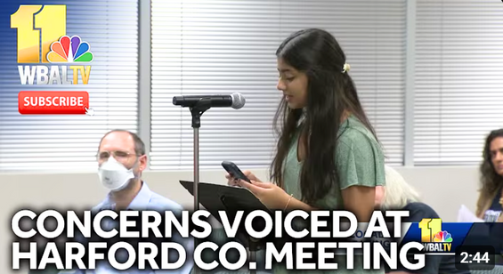

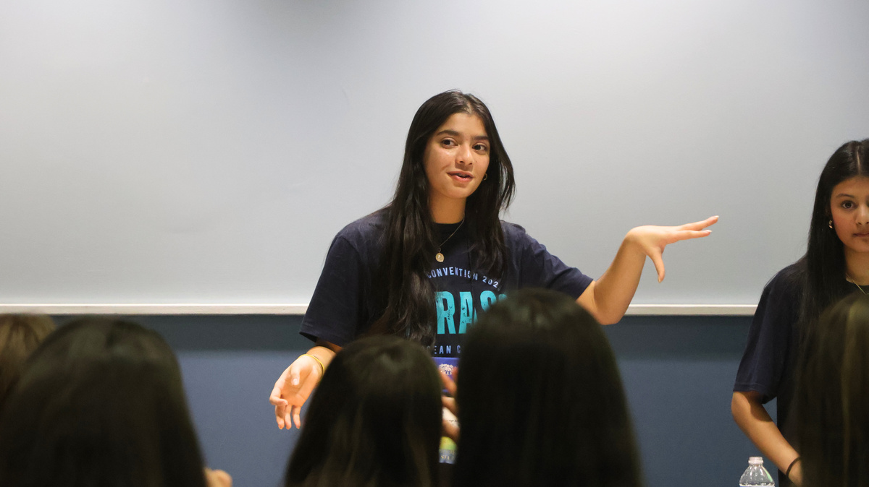
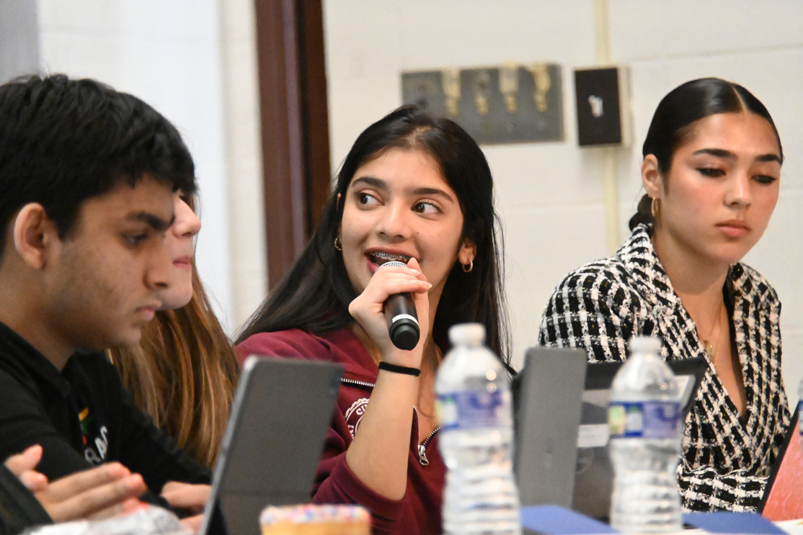
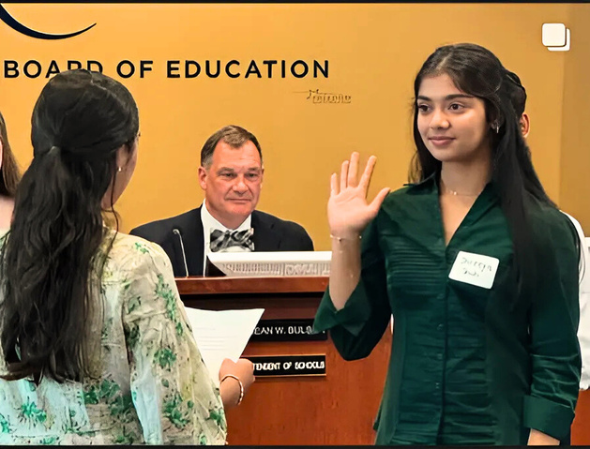
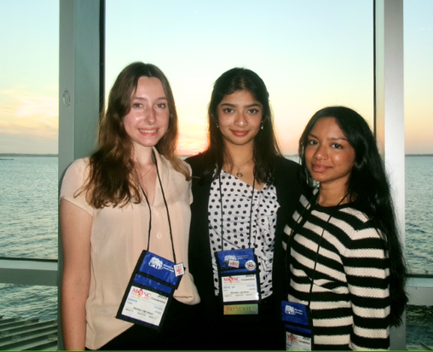
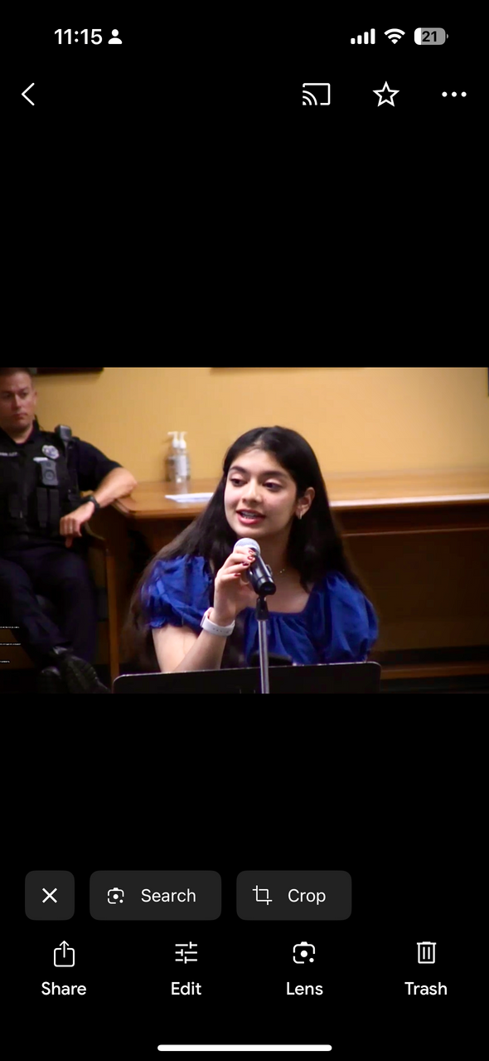
Science and Mathematics Academy
Shreeya Shah
Patterson Middle School
Neuroscience & Business Major
Extracurriculars
  Harford County Student Gov. President
  Nonprofit Founder: SunkissedByShakti
  EMT Training
  Science Honor Society, President
  Math Honor Society, Officer
  NeuroEd, Founder & President
  Speech and Debate, President
  Mock Trial, Attorney
  Varsity Volleyball

Slide 29
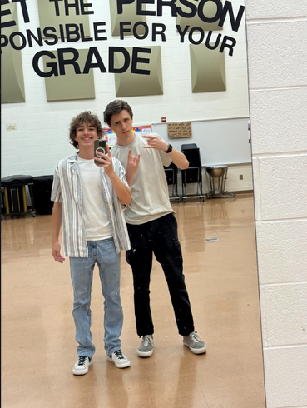
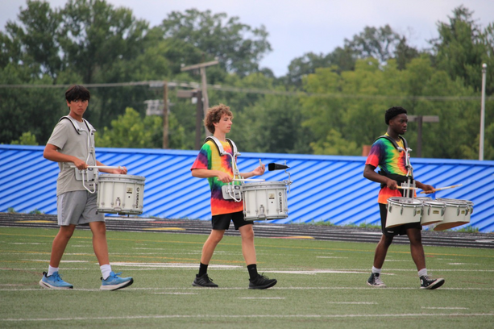
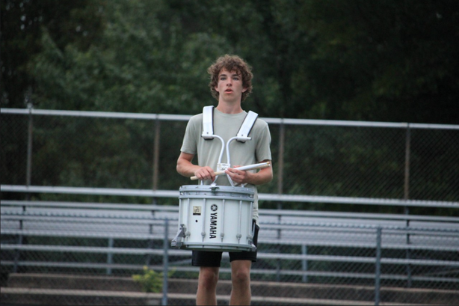
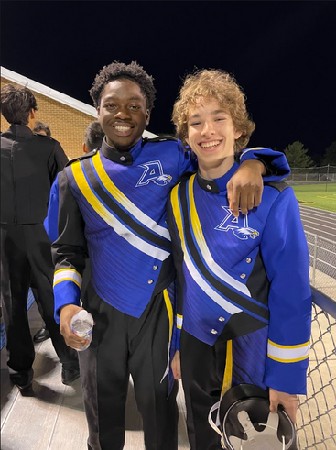
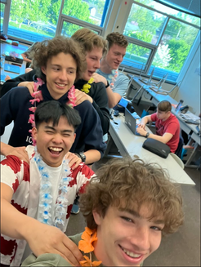
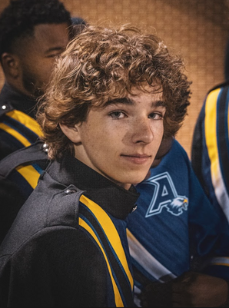
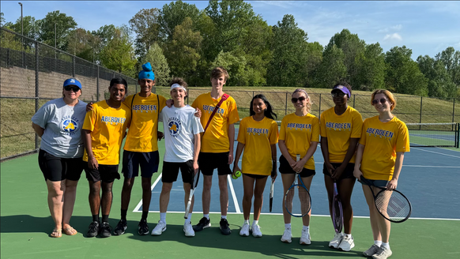
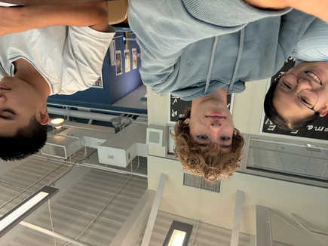
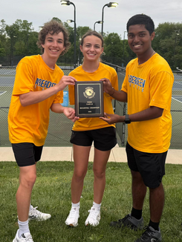
Science and Mathematics Academy
Jack Newberry
Southampton Middle School
Electrical & Computer Engineering Major
Extracurriculars
  Aberdeen Marching Eagles Drum Captain
  Aberdeen Jazz Band
  Harford County All Honors Band & Orchestra
  Varsity Tennis Captain
  Academic Team
  Coding Club
  SGA
  Nation Honors Society
  Chess Club

Slide 30

Science and Mathematics Academy
Why did we join SMA?
STEM focus
Inspires you to achieve more
Prepares you for a STEM major
Unique SMA electives
To form deeper understandings
SRT classes & capstone project

Slide 31
Science and Mathematics Academy
Why is it worth it?
Commitment to ourselves
Inspires you to achieve more
Knowledgeable mentors and teachers
Strengthened academic persistence
Found a community

Slide 32
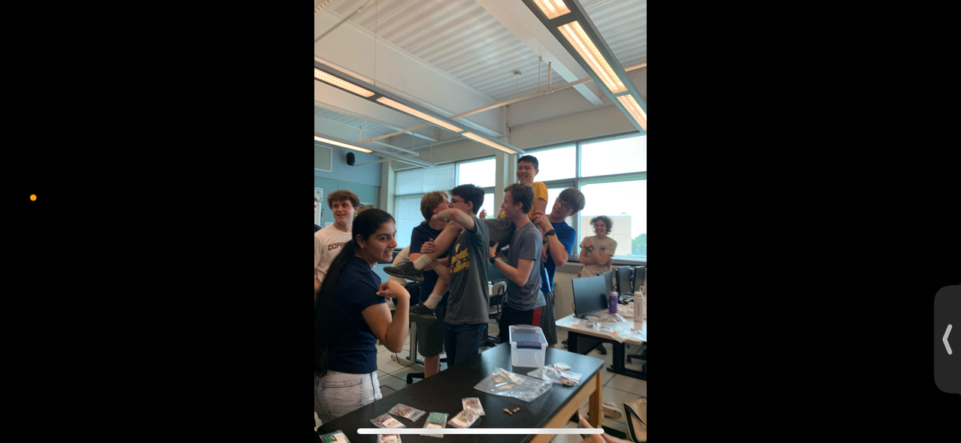
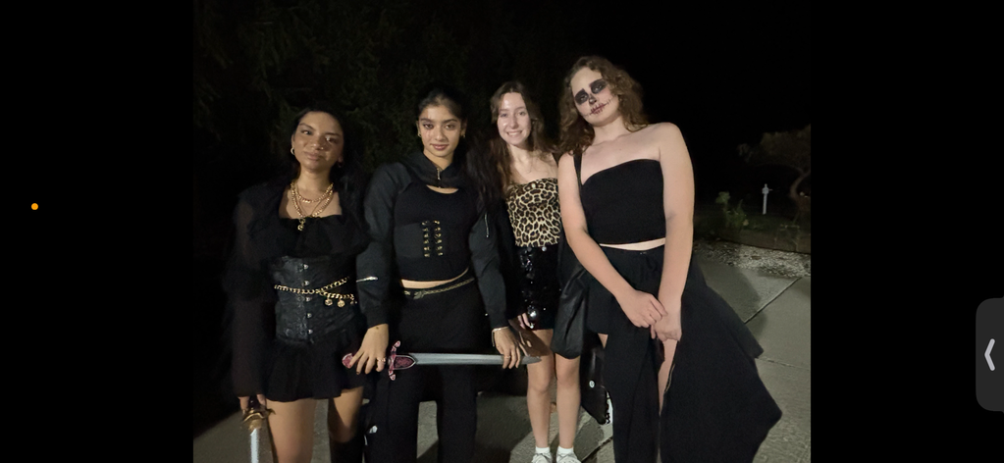
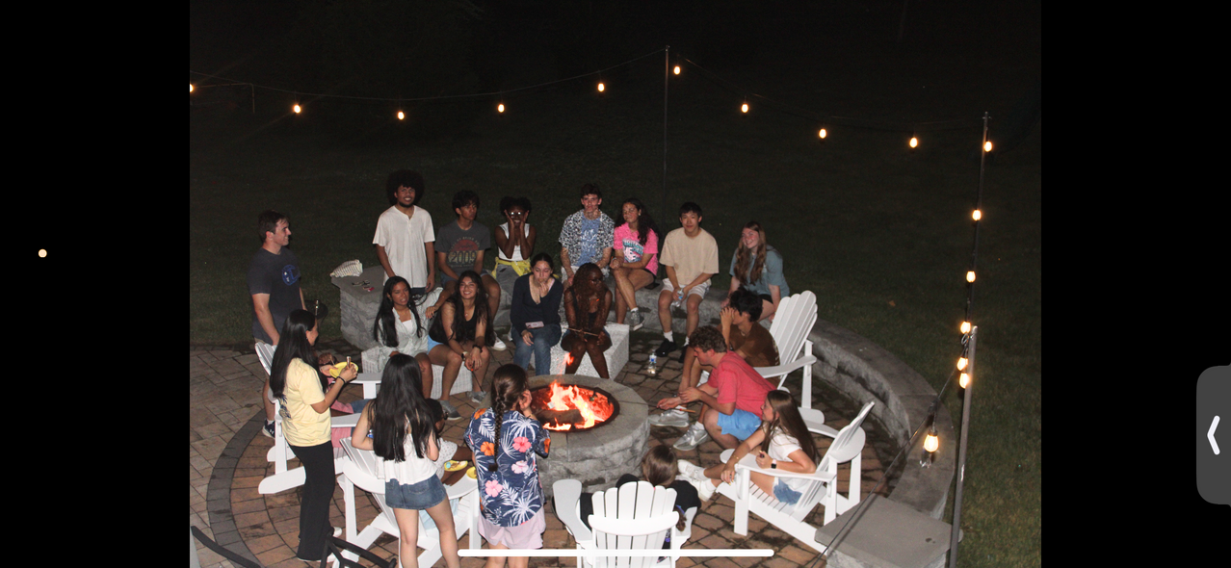
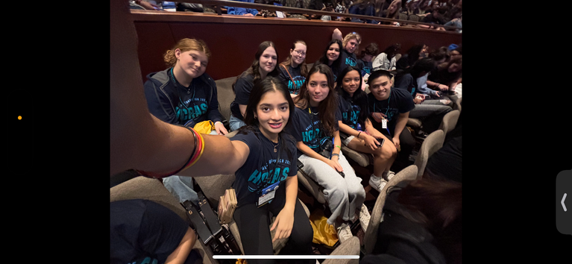
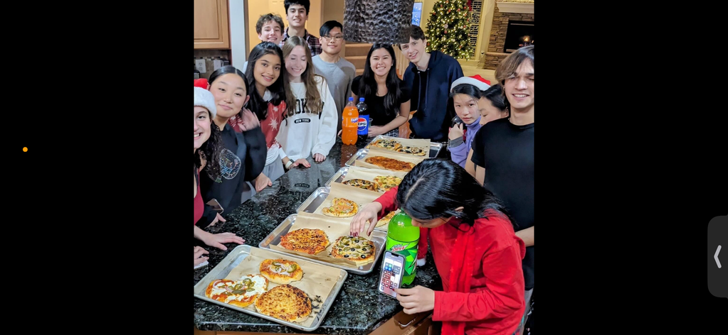
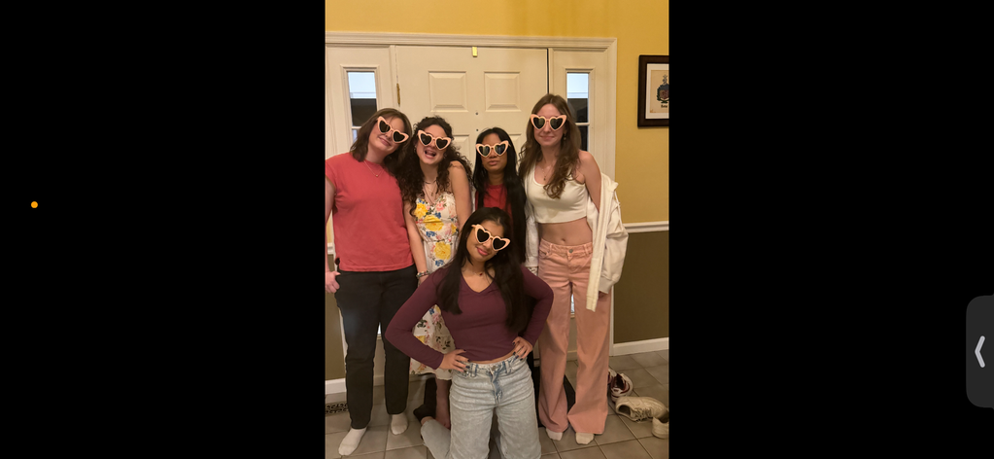
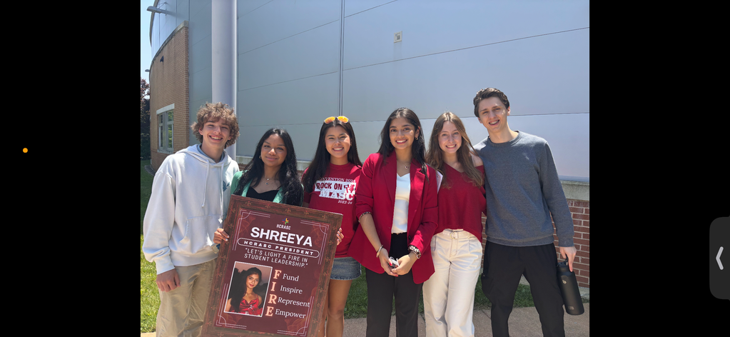
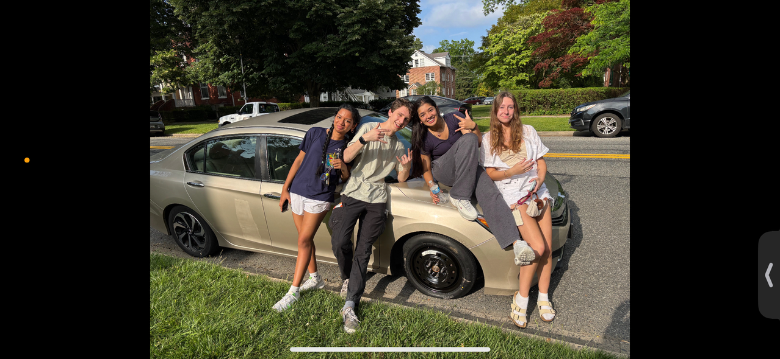
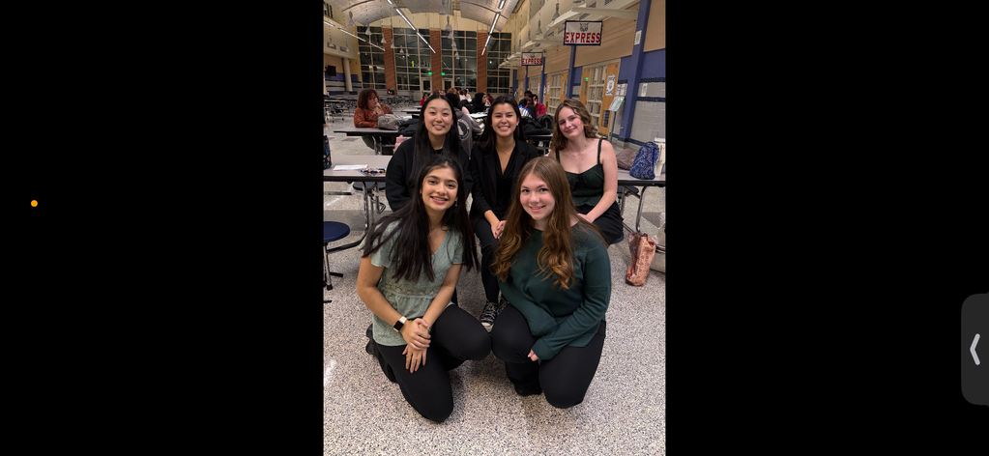










Science and Mathematics Academy
Our Community

Slide 33
Science and Mathematics Academy
How to be successful
What to do...
What not to do...
Stay organized
Procrastinate
Self Advocate
Take feedback personally
Get enough sleep
Be easily overwhelmed
Stay engaged
Have a negative attitude

Slide 34






Science and Mathematics Academy
Life Sciences

Slide 35







Science and Mathematics Academy
Life Sciences

Slide 36








Science and Mathematics Academy
Robotics

Slide 37







Science and Mathematics Academy
Engineering

Slide 38










Science and Mathematics Academy
Peer Experiments

Slide 39





Science and Mathematics Academy
Independent Research

Slide 40





Science and Math Academy
Shreeya’s Capstone
Determining Impacts of Aided Target Recognition (AiTR) on Soldier Situational Awareness

Slide 41


Science and Mathematics Academy
Jack’s Capstone
Extending the flight envelope of autonomous UAVs through high-efficiency base-station charging

Slide 42









Science and Math Academy
Meet the Teachers
Ms. Ashley
Mr. Evans
Ms. Gabriel
Program Specialist/ Math
Math/Robotics
Sciences
Ms. Liberto
Mr. Polack
Mr. Homishak
Math
Statistics/Comp Sci
Biology
Mr. Sherid
Mr. Simmons
Mr. Webster
Physics
Chemistry
Engineering

Slide 43

Science and Mathematics Academy
QUESTIONS?

Slide 44

Science and Mathematics Academy
THANK YOU

Slide 45
Tour Groups
Your tour group number is on your INDEX CARD
Your tour guides are in the lobby
Staggered Start:
Groups #1 – 8
Groups #9 – 16
To get the most out of your tour experience please stay with your tour guide!

Slide 46

For further information, please contact:
Mrs. Sarah Ashley
SMA Program Specialist sarah.ashley@hcps.org
410.273.5500
Find us on the web:
scienceandmathacademy.com
@Aberdeen_SMA

